Slide 1
Forest frog series
maintenance guide

Slide 2
Contents
1 General information … … … … … … … … … … … 2
2 Installation guide … … … … … … … … … … … … 4
3 Common malfunctions and maintenance … … 13

Slide 3
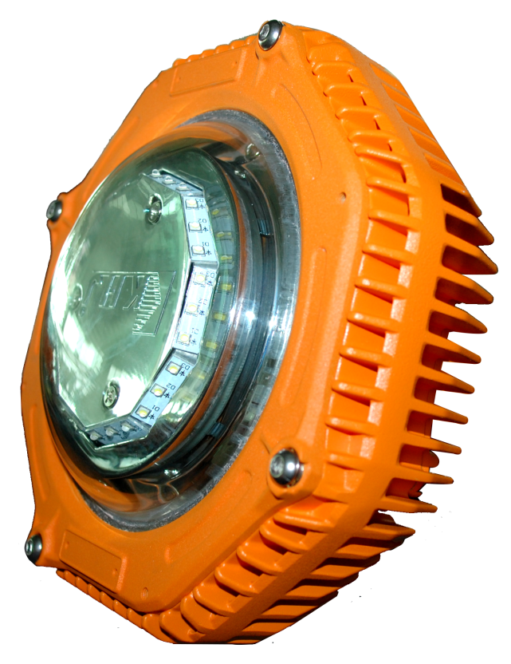
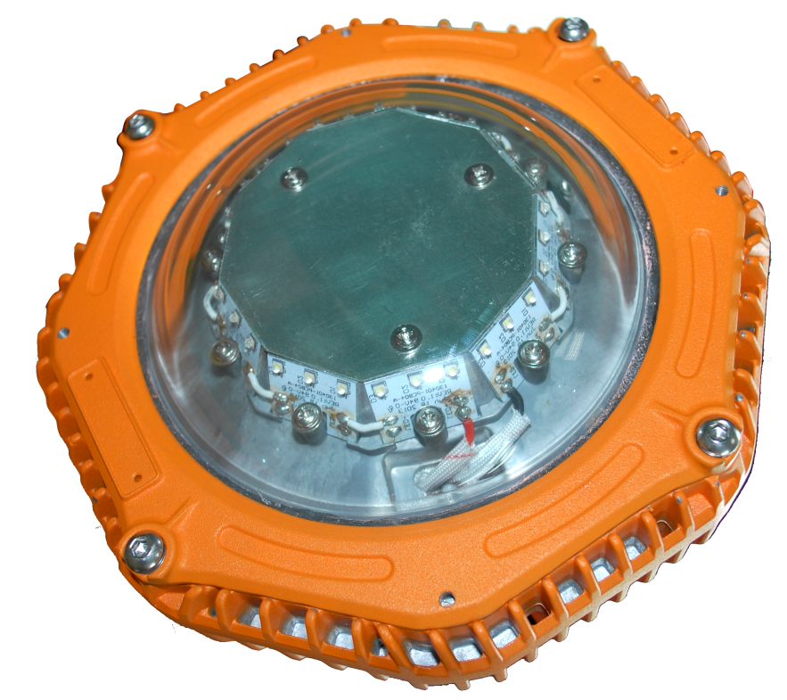
1. Appearance

Slide 4
2. Product summary
A. Features
This series adopts LED lighting module which features high efficiency, high lumen output and long lifespan. Adopting integrated design, the lighting fixture is made of high strength aluminum alloy.
Junction box and LED lighting source are isolated to increase the safety and reliability.
B. Main purpose and applicable scope
The explosion-proof series is applicable to the flammable places in oil field, Petroleum industry , petrochemical industry, etc.
The industrial series is applicable to the normal workshop, warehouse etc.
C. The ambient temperature is -45℃to +45℃
D. Certificate
PCEC(China)

Slide 5
1. Caution
A. Installation and maintenance should be done by professional staff
B. Avoid explosion
a. Ensure that the voltage of power supply is within the range marked on the label
b. Don’t install the product in any flammable places that the temperature is over the temperature level marked on the label
C. Prevent electric shock and burns
a. Forbidden install or maintain with power
b. The enclosure should be earthed reliably
c. Don’t touch the transparent parts to prevent burns when it is power on

Slide 6
2. Installation
There are 8 mounting types.
Please select the mounting type according to the actual requirement.

Slide 7
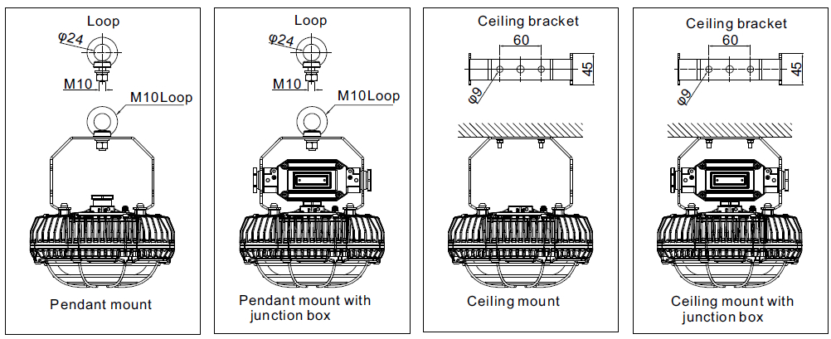
2. Installation

Slide 8
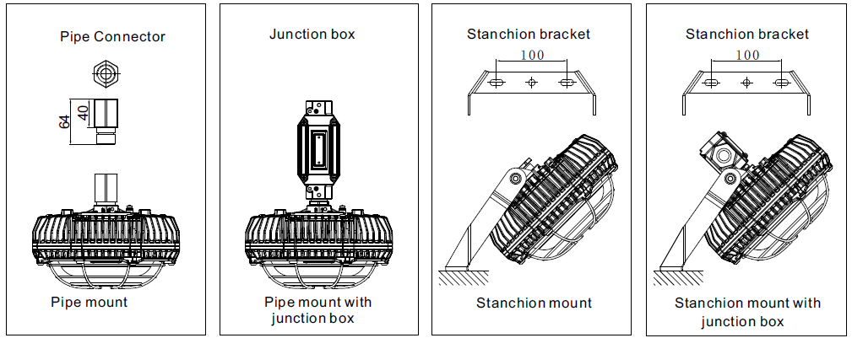
2. Installation

Slide 9
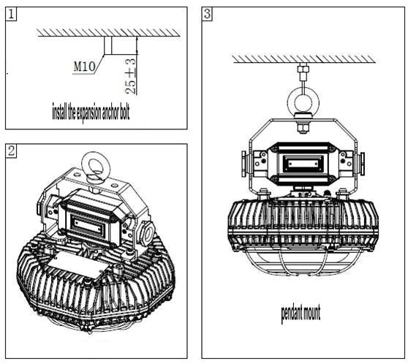
2. Installation
pendant mount

Slide 10
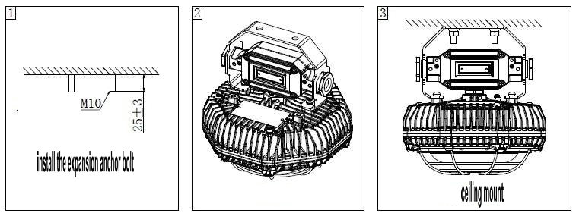
2. Installation
ceiling mount

Slide 11
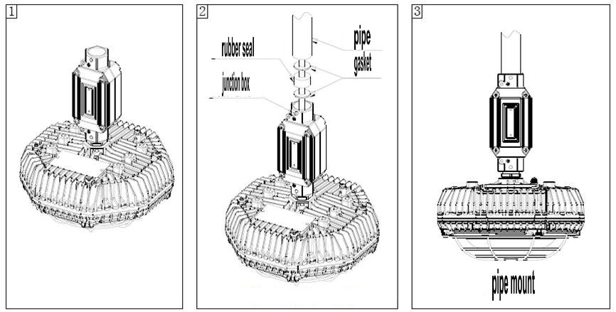
2. Installation
pipe mount

Slide 12
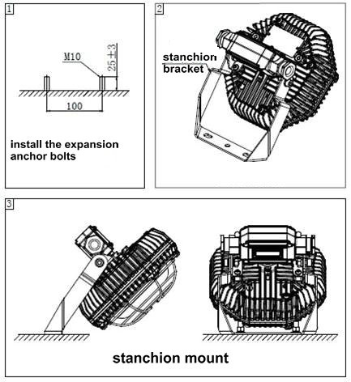
2. Installation
stanchion mount

Slide 13
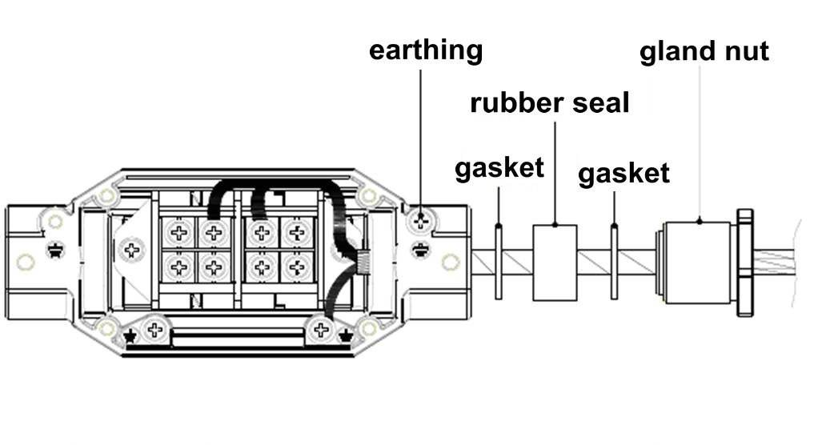
3. Electrical connection

Slide 14
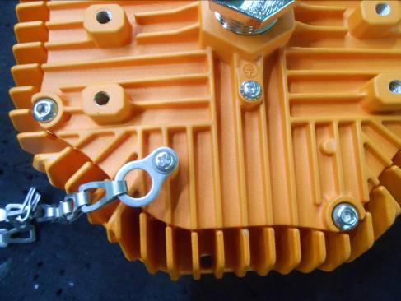
4. Fall proof chain
Fix one end of the chain to the enclosure and the other end to the mounting surface so as to prevent the lighting fixture to fall accidentally.

Slide 15
5. Operation caution
Not use the lighting fixture lacks some parts.
Do not touch the enclosure or glass to avoid the burns to your hands during the operation.

Slide 16
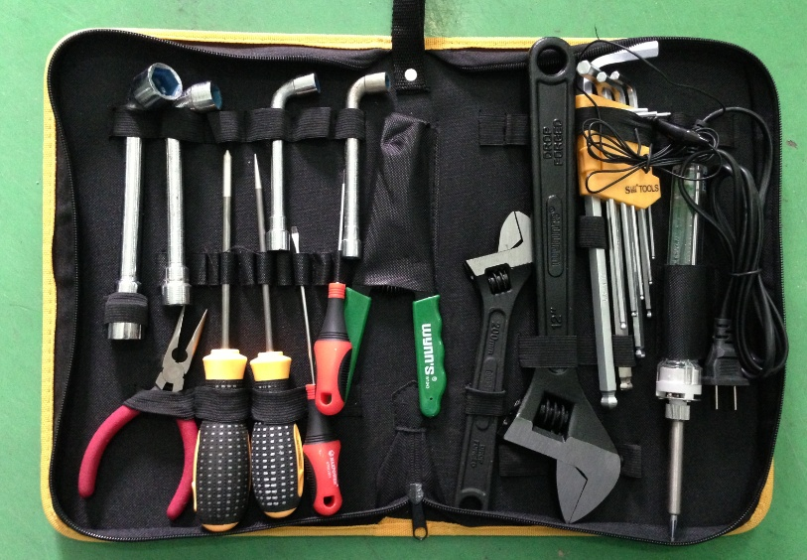
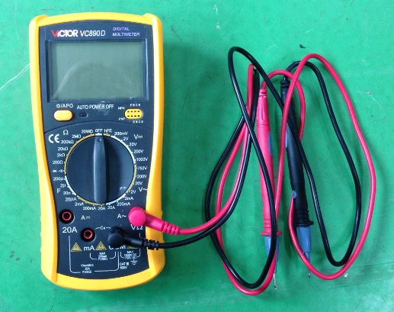
1. Preparation of tools
Common tools：
Philips screwdriver , straight screwdriver , internal hexagonal wrench ,
adjustable spanner , pliers , etc.
Universal meter

Slide 17
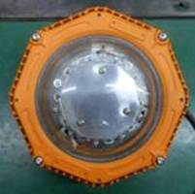
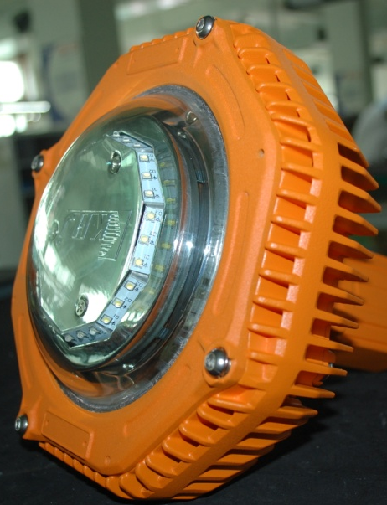
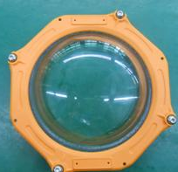
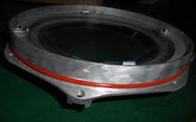
2. Crack on the glass
Analysis: The impact energy on the glass is over 20J that is the max. limit for the toughened glass
Solution: replace the lamp cover ( include the glass )
Open the lamp cover(maybe you need a small screwdriver to pry)
Loosen the screws
Assemble a new lamp cover
Clean the cracked glass

Slide 18
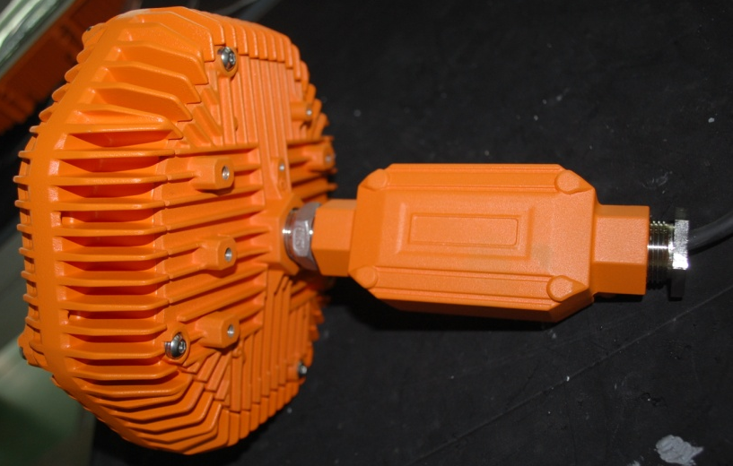
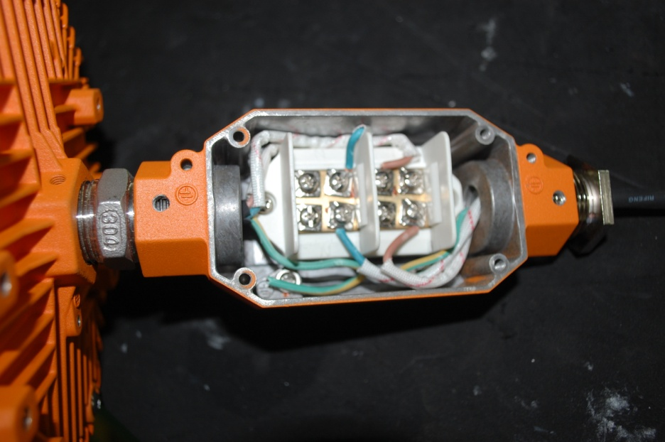
3. Lamp failure
3.1 Analysis: Power supply is failed( a lamp with junction box)
Solution: Measure whether the voltage is normal on the terminal block. If there is no power , check the power supply outside. If the voltage is normal , check the circuit inside.
Use the universal meter to measure the terminal block (L and N poles) and compare the value and the rated input voltage on the label.
Loosen the screws

Slide 19
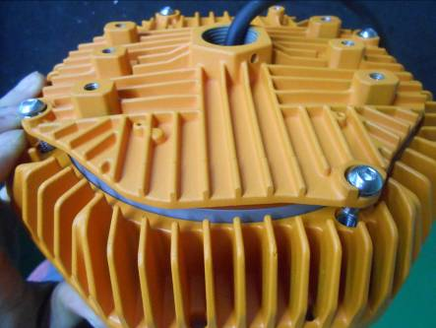
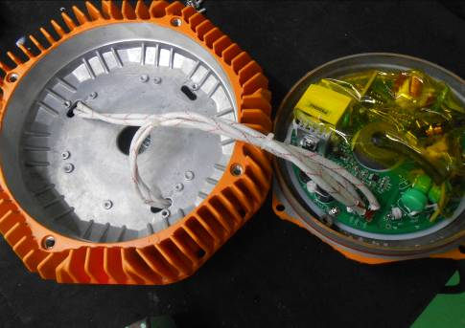
3. Lamp failure
3.1 Analysis: Power supply is failed( a lamp without junction box)
Solution: Measure whether the voltage is normal on the power supply board. If there is no power , check the power supply outside. If the voltage is normal , check other parts of the board.
Use the universal meter to measure the terminal block (L and N poles) and compare the value and the rated input voltage on the label.
Loosen the screw and open the back cover

Slide 20
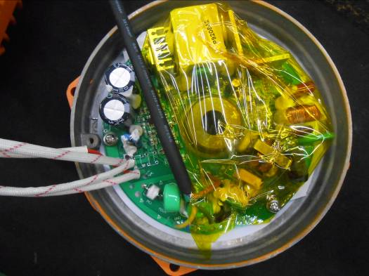
3. Lamp failure
3.2 Analysis: the power supply board is failed
Solution: Observe whether some electronic components are damaged and give off bad smell. If not , measure whether the voltage is normal on the output terminal. If there is no voltage ( DC ) or very low , replace the power supply board . If the output is normal , check the LED board
Check the output voltage

Slide 21
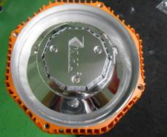
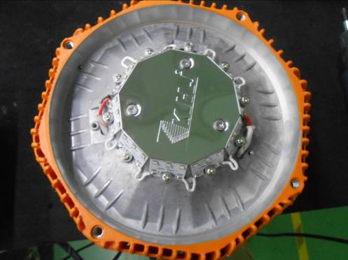
3. Lamp failure
3.2 Analysis: the LED board is failed
Solution: Measure the voltage between “+”and “-”on the LED board . If the voltage is normal , replace the LED board.
If not , check the cables and connector from the power board to the LED board, then measure again.
Open the lamp cover
Loosen the screws
Remove the reflector
Check the input voltage

Slide 22
4. LED flash rapidly
Analysis: Reference to the steps of 3. Lamp failure
Solution:

Slide 23
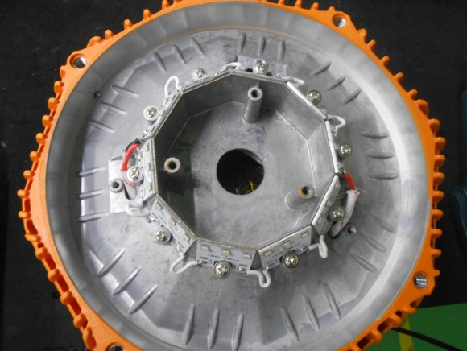
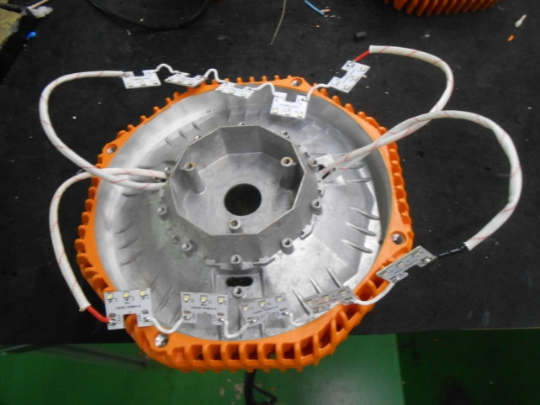
5. How to replace the LED board
Open the lamp cover ( maybe you need a small screws driver to pry)
Loosen the screws
Unsolder the power cables
Remove the reflector

Slide 24
5. How to replace the LED board
Open the package of the new LED board, install it by reverse operation of the 5 How to replace the LED board
Caution：
The lighting fixture should be energized more than 2 hours before tighten the screws to evaporate the water inside , then, shut down and tighten all screws.

Slide 25
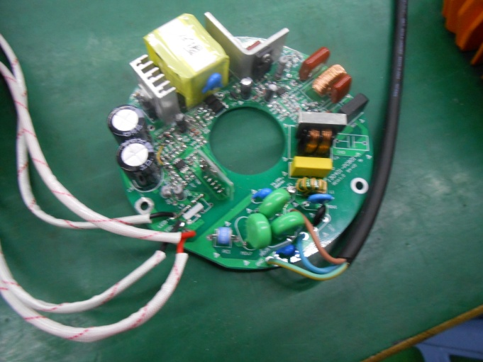
6. How to replace the power supply board
Open the back cover
dismantle the power supply board
Unsolder the input cables and output cables

Slide 26
6. How to replace the LED board
Open the package of the new power supply board, install it by reverse operation of the 6. How to replace the LED board
Caution：
The lighting fixture should be energized more than 2 hours before tighten the screws to evaporate the water inside , then, shut down and tighten all screws.

Slide 27
THANKS！

