Slide 1
Polar bear series maintenance guide

Slide 2
Contents
1 General information … … … … … … … … … … … 2
2 Installation guide … … … … … … … … … … … … 4
3 Common malfunctions and maintenance … … 13

Slide 3
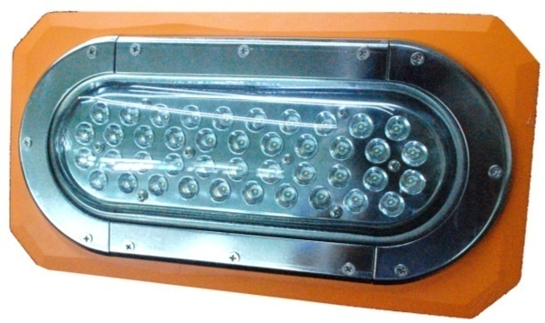
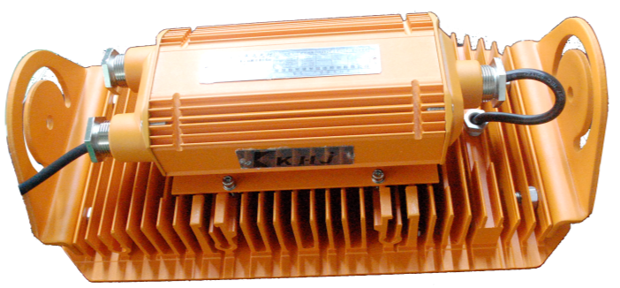
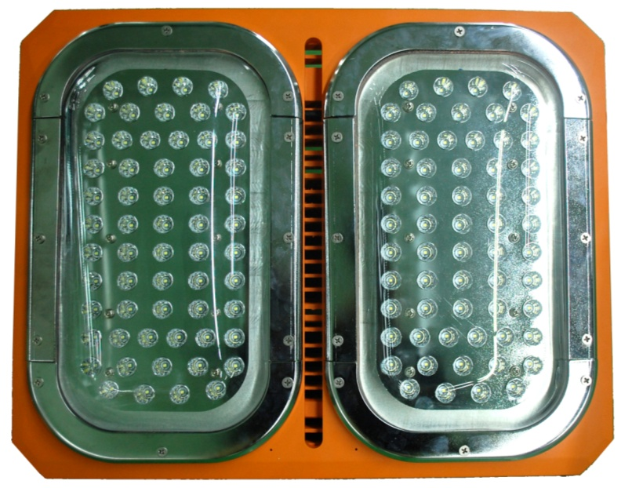
1. Appearance

Slide 4
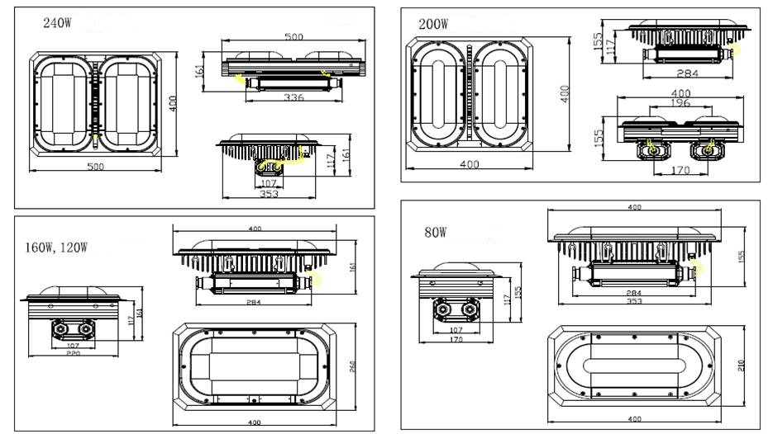
1. Appearance

Slide 5
2. Product summary
A. Features
This series adopts LED lighting module which features high efficiency, high lumen output and long lifespan. Adopting integrated design, the lighting fixture is made of high strength aluminum alloy.
Junction box and LED lighting source are isolated to increase the safety and reliability.
B. Main purpose and applicable scope
The explosion-proof series is applicable to the flammable places in oil field, Petroleum industry , petrochemical industry, etc.
The industrial series is applicable to the normal workshop, warehouse etc.
C. The ambient temperature is -40℃to +40℃
D. Certificate
PCEC(China)/MA(china)/CQC(china)/ATEX/IECEX/CE/ROHS

Slide 6
1. Caution
A. Installation and maintenance should be done by professional staff
B. Avoid explosion
a. Ensure that the voltage of power supply is within the range marked on the label
b. Don’t install the product in any flammable places that the temperature is over the temperature level marked on the label
C. Prevent electric shock and burns
a. Forbidden install or maintain with power
b. The enclosure should be earthed reliably
c. Don’t touch the transparent parts to prevent burns when it is power on

Slide 7
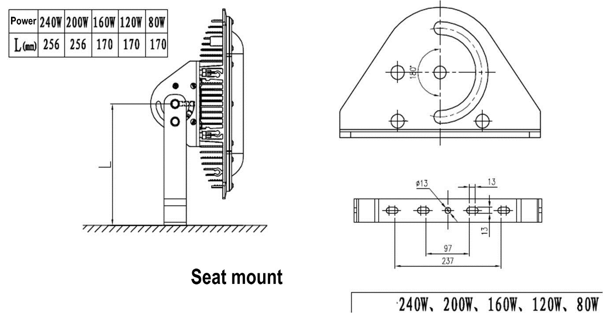
2. Installation
There are 5 mounting types:, seat mount, wall mount, pendant mount , stanchion mount, pipe clamp mount. Please select the mounting type according to the actual requirement.

Slide 8
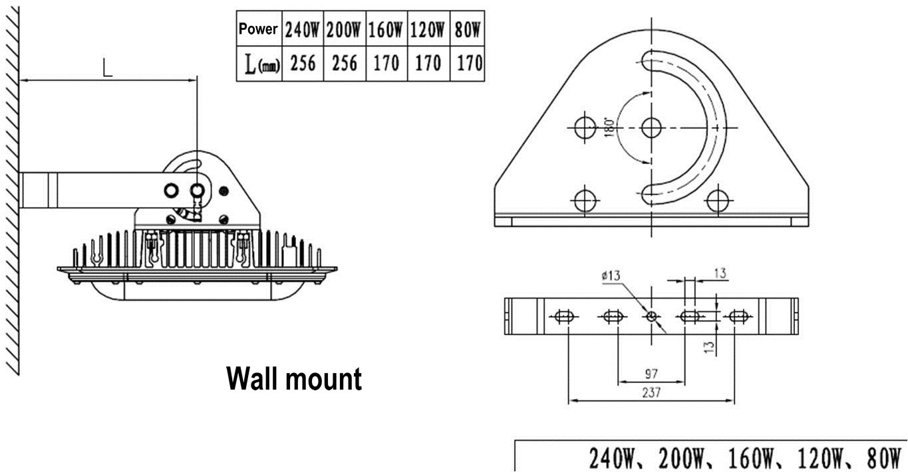
2. Installation
There are 5 mounting types:, seat mount, wall mount, pendant mount , stanchion mount, pipe clamp mount. Please select the mounting type according to the actual requirement.

Slide 9
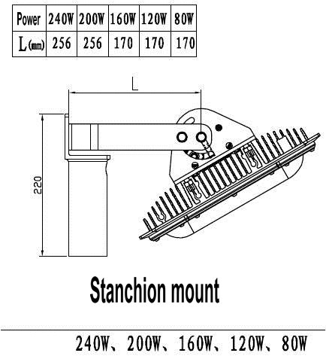
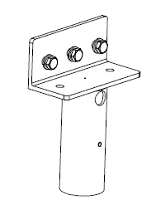
2. Installation
There are 5 mounting types:, seat mount, wall mount, pendant mount , stanchion mount, pipe clamp mount. Please select the mounting type according to the actual requirement.

Slide 10
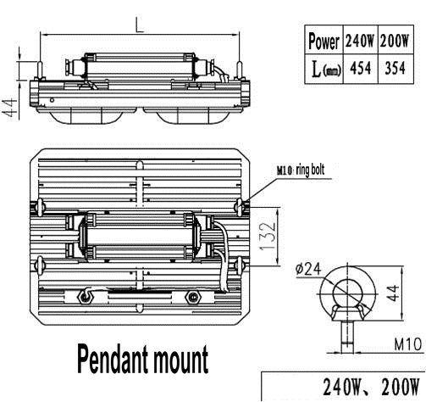
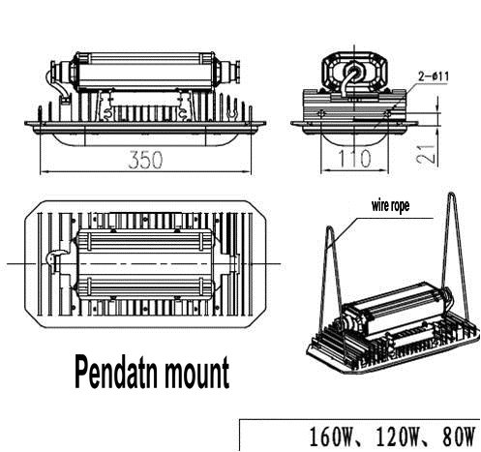
2. Installation
There are 5 mounting types:, seat mount, wall mount, pendant mount , stanchion mount, pipe clamp mount. Please select the mounting type according to the actual requirement.

Slide 11
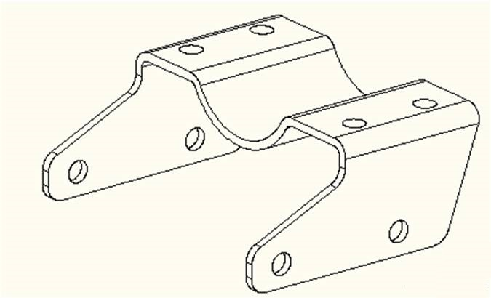
2. Installation
There are 5 mounting types:, seat mount, wall mount, pendant mount , stanchion mount, pipe clamp mount. Please select the mounting type according to the actual requirement.
Apply for:160W,120W,80W

Slide 12
2. Installation
A. Seat mount & B. Wall mount
Install 2 expansion bolts at the predetermined position on the wall or other flat surface according to the holes in the bracket. Mount the bracket on the enclosure . Connect the bracket to the 2 expansion bolts and fasten them.

Slide 13
2. Installation
C. Pendant mount
200/240W ，4 ring bolts
80/120/160W ，2 holes in each side for wire ropes customer supplied

Slide 14
2. Installation
D. Stanchion mount

Slide 15
2. Installation
E. Pipe clamp mount( 80/120/160W)

Slide 16
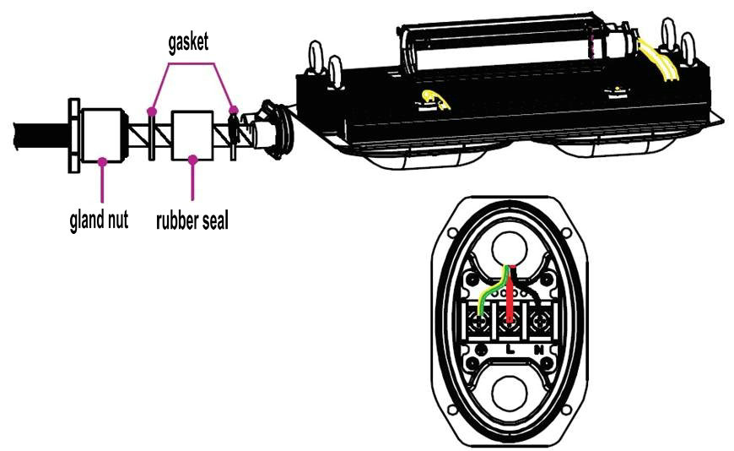
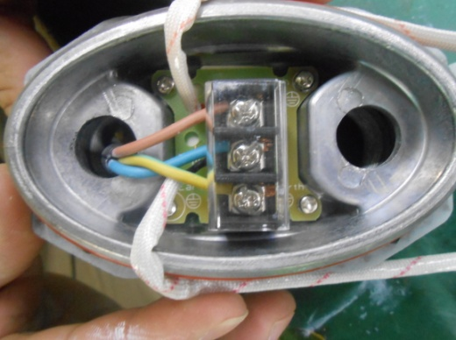
3. Electrical connection
Open the cover of the power box

Slide 17
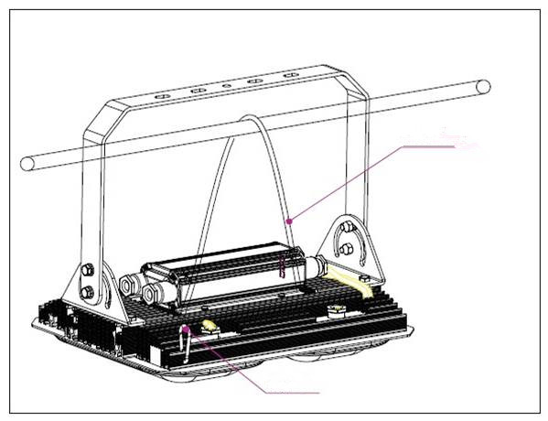
4. Fall proof chain
Fix the chain to the enclosure and hang the lamp on the beam
Safety chain
Buckle

Slide 18
5. Operation caution
Not use the lighting fixture lacks some parts.
Do not touch the enclosure or glass to avoid the burns to your hands during the operation.

Slide 19
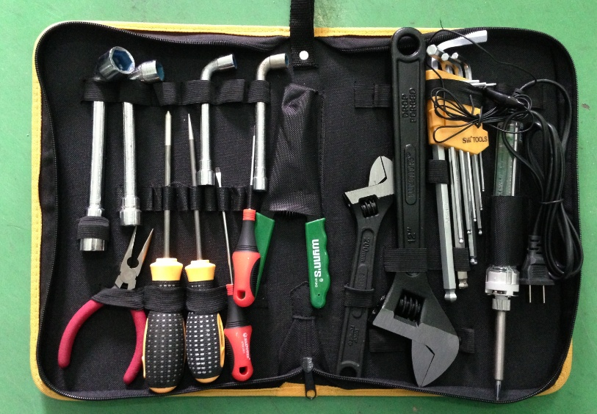
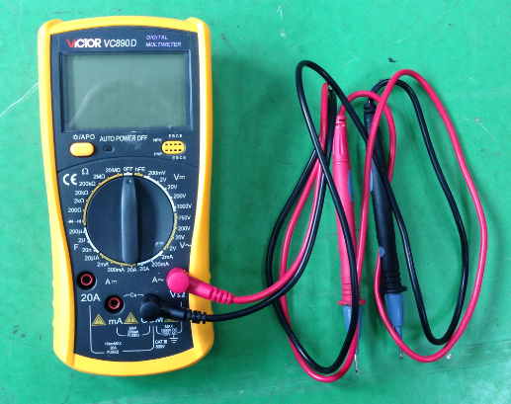
1. Preparation of tools
Common tools：
Philips screwdriver , straight screwdriver , internal hexagonal wrench ,
adjustable spanner , pliers , etc.
Universal meter

Slide 20
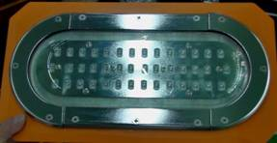
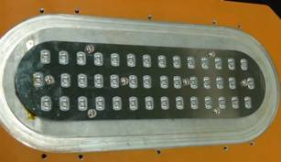
2. Crack on the glass
Analysis: The impact energy on the glass is over 20J that is the max. limit for the toughened glass
Solution: replace the lamp cover ( include the glass )
Steps :
A. loosen the screws with 5mm inner hexagonal wrench and remove the cracked cover
Remove the screws and press plate
Remove the glass

Slide 21
3. Lamp failure
3.1 Analysis: Power supply is failed
Solution: Measure whether the voltage is normal on the terminal block. If there is no power , check the power supply outside. If the voltage is normal , check the circuit inside.
Terminal block
Power cable

Slide 22
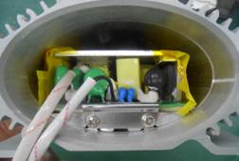
3. Lamp failure
3.2 Analysis: No power on the input terminal of the power supply board
Solution: Measure whether the voltage is normal on the input terminal of the power supply board. If there is no power , check whether there is poor contact from terminal block to the input terminal. If the voltage is normal , check other parts of the board.
Check the voltage here

Slide 23
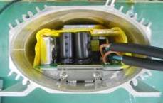
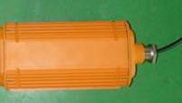
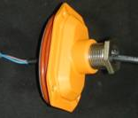
3. Lamp failure
3.2 Analysis: the power supply board is failed
Solution: Observe whether some electronic components are damaged and give off bad smell. If not , measure whether the voltage is normal on the output terminal. If there is no voltage ( DC ) or very low , replace the power supply board . If the output is normal , check the LED board
Check the output voltage
80W、120W、160W
Open the other cover(output)

Slide 24
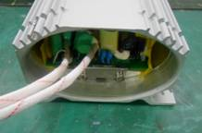
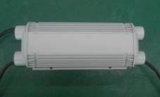
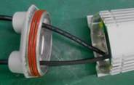
3. Lamp failure
3.2 Analysis: the power supply board is failed
Solution: Observe whether some electronic components are damaged and give off bad smell. If not , measure whether the voltage is normal on the output terminal. If there is no voltage ( DC ) or very low , replace the power supply board . If the output is normal , check the LED board
Open the other cover(output)
Check the output voltage
200W 240W

Slide 25
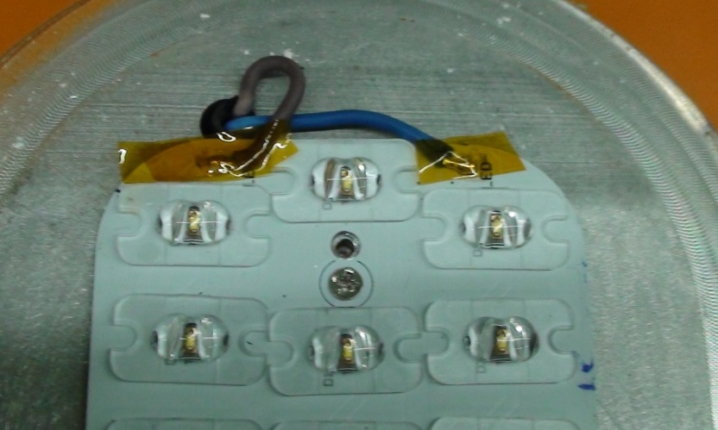
3. Lamp failure
3.2 Analysis: the LED board is failed
Solution: Measure the voltage between “+”and “-”on the LED board . If the voltage is normal , replace the LED board.
If not , check the cables and connector from the power board to the LED board, then measure again.
Open the glass cover and check the voltage

Slide 26
6. LED flash rapidly
Analysis: Reference to the steps of 3. Lamp failure
Solution:

Slide 27
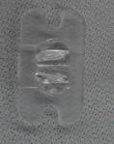
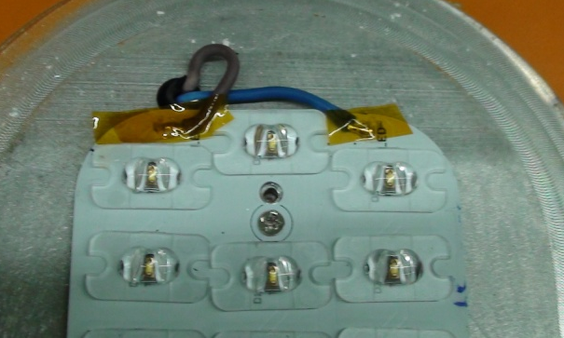
7 how to replace the LED board
Remove the reflector cover
Open the glass cover
Unsolder the power cables
Remove the reflectores

Slide 28
7 How to replace the LED board
Open the package of the new LED board, install it by reverse operation of the 7 How to replace the LED board
Caution：
The lighting fixture should be energized more than 2 hours before tighten the screws to evaporate the water inside , then, shut down and tighten all screws.

Slide 29
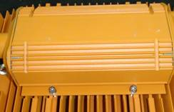
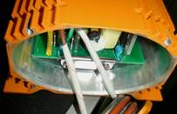
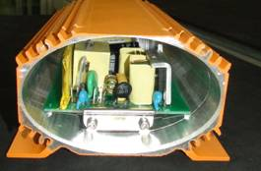
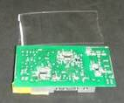
8. How to replace the power supply board
8.1 80W 120W 160W
Open the input and output covers and unsolder al power cables
Dismantle the power box
Loosen the screws and remover the power board

Slide 30
8 How to replace the power supply board
Open the package of the new power supply board, install it by reverse operation of the 8.1 80W 120W 160W
Caution：
The lighting fixture should be energized more than 2 hours before tighten the screws to evaporate the water inside , then, shut down and tighten all screws.

Slide 31
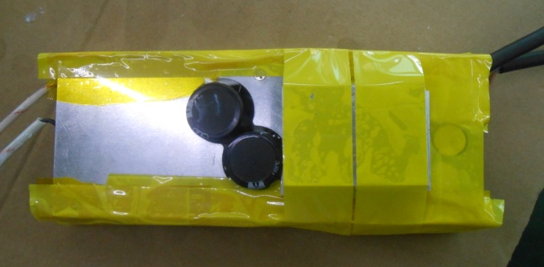
8. How to replace the power supply board
8.2 200W 240W
Open the input and output covers and unsolder al power cables
Dismantle the power box
Loosen the screws and remover the power board

Slide 32
8 How to replace the power supply board
Open the package of the new power supply board, install it by reverse operation of the 8.2 80W 120W 160W
Caution：
The lighting fixture should be energized more than 2 hours before tighten the screws to evaporate the water inside , then, shut down and tighten all screws.

Slide 33
THANKS！

