Slide 1
Frog series maintenance guide

Slide 2
目 录
1、产品信息… … … … … … … … … … … … … 2
2、安装指导… … … … … … … … … … … … … 5
3、常见故障排查 … … … … … … … … … … …15

Slide 3
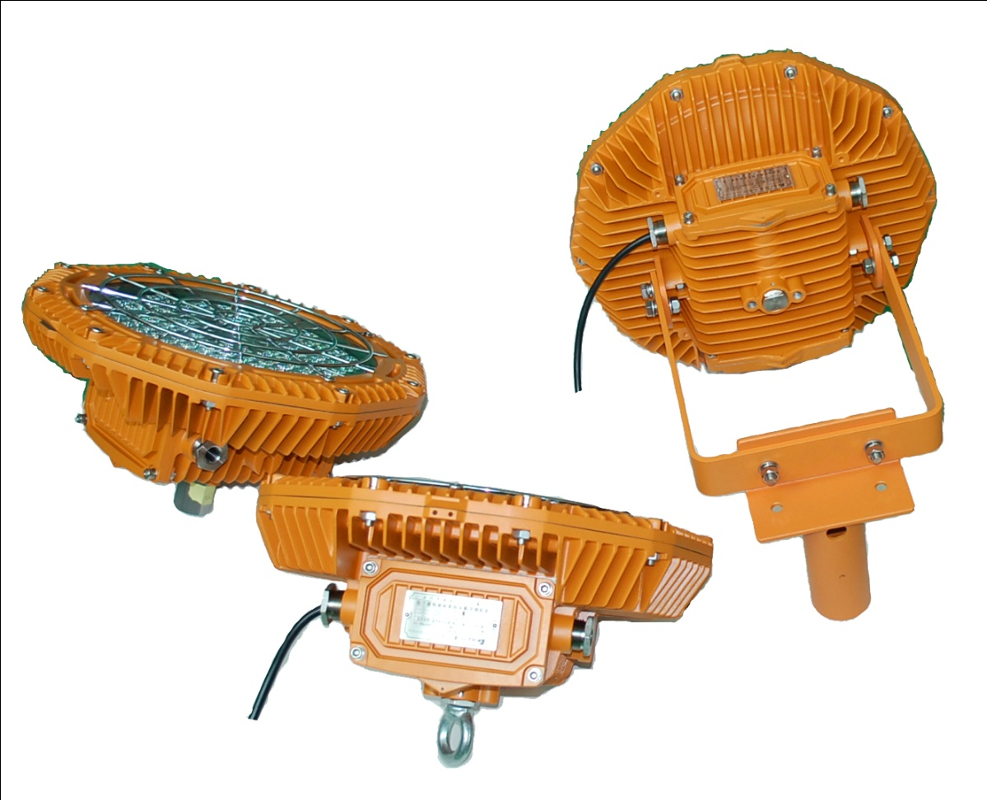
1. Appearance

Slide 4
2. Product summary
A. Features
This series adopts LED lighting module which features high efficiency, high lumen output and long lifespan. Adopting integrated design, the lighting fixture is made of high strength aluminum alloy.
Junction box and LED lighting source are isolated to increase the safety and reliability.
B. Main purpose and applicable scope
Applicable the flammable places in oil field, Petroleum industry , petrochemical industry, etc.
C. The ambient temperature is -40℃to +55℃
D. Certificate
PCEC(China)/ATEX/IECEX

Slide 5
1. Caution
A. Installation and maintenance should be done by professional staff
B. Avoid explosion
a. Ensure that the voltage of power supply is within the range marked on the label
b. Don’t install the product in any flammable places that the temperature is over the temperature level marked on the label
C. Prevent electric shock and burns
a. Forbidden install or maintain with power
b. The enclosure should be earthed reliably
c. Don’t touch the transparent parts to prevent burns when it is power on

Slide 6
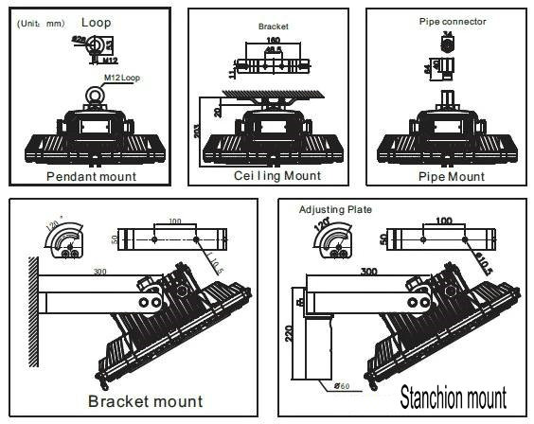
2. Installation
There are 5 mounting types: ceiling mount , pendant mount , bracket mount , suspender mount and stanchion mount . Please select the mounting type according to the actual requirement.

Slide 7
2. Installation
A. Ceiling mount
Install 2 expansion bolts at the predetermined position on the ceiling according to the holes in the bracket . Mount the bracket on the enclosure . Connect the bracket to the 2 expansion bolts and fasten them.

Slide 8
2. Installation
B. Pendant mount
Install 1expansion bolt at the predetermined position on the ceiling according to the ring bolt holes in the enclosure. Mount the 1 ring bolt in the enclosure . Connect the ring bolt to the expansion bolt with wire rope and fasten them.

Slide 9
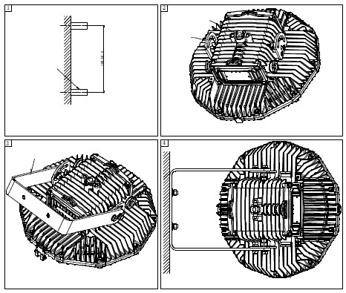
2. Installation
C. Bracket mount
Install 2 expansion bolts at the predetermined position on the wall or other flat surface according to the holes in the bracket. Mount the bracket on the enclosure . Connect the bracket to the 2 expansion bolts and fasten them.

Slide 10
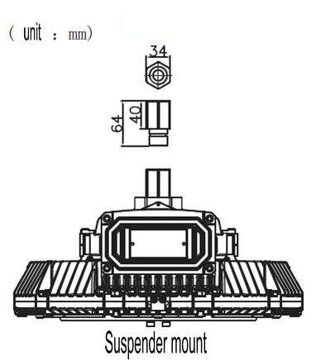
2. Installation
D. Suspender mount
Mount the 1 suspender connector in the enclosure . Connect connector to the light pole

Slide 11
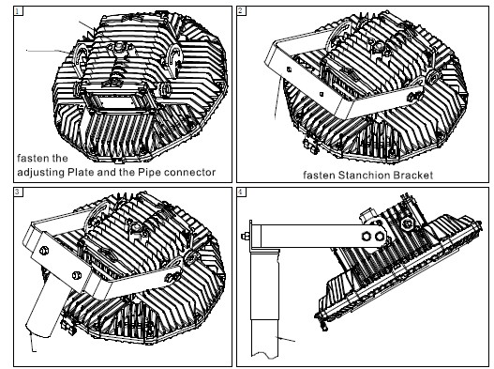
2. Installation
D. Stanchion mount
Assemble 2 adjusting plates and 1 bracket on the enclosure. Then connect the bracket to the pole connector by screws.
Put the pole connector over the light pole and fasten them.

Slide 12
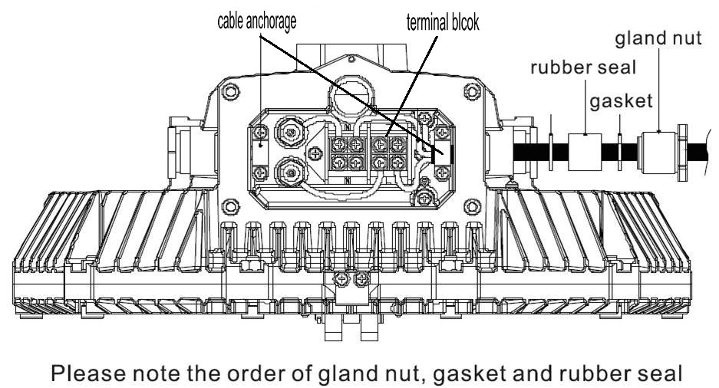
3. Electrical connection

Slide 13
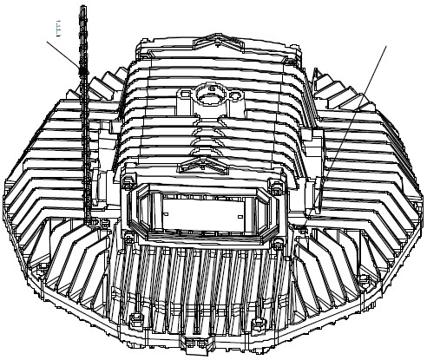
4. Fall proof chain
Fix one end of the chain to the enclosure and the other end to the mounting surface so as to prevent the lighting fixture to fall accidentally.
Fall proof chain

Slide 14
5. Operation caution
Not use the lighting fixture lacks some parts.
Do not touch the enclosure or glass to avoid the burns to your hands during the operation.

Slide 15
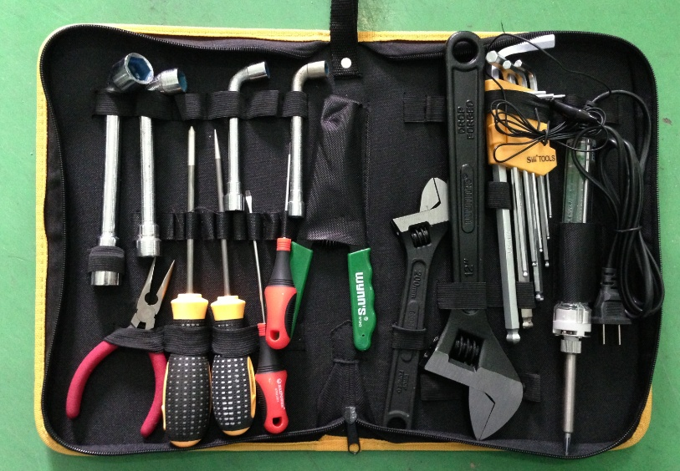
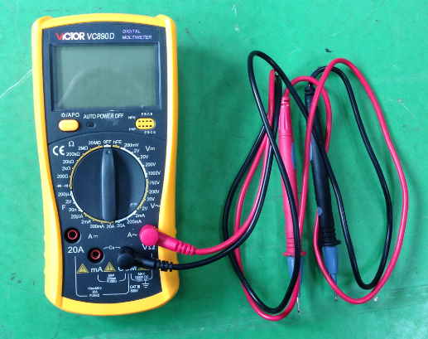
1. Preparation of tools
Common tools：
Philips screwdriver , straight screwdriver , internal hexagonal wrench ,
adjustable spanner , pliers , etc.
Universal meter

Slide 16
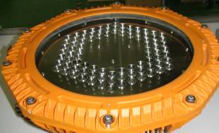
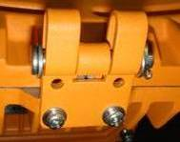
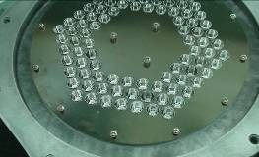
2. Crack on the glass
Analysis: The impact energy on the glass is over 20J that is the max. limit for the toughened glass
Solution: replace the lamp cover ( include the glass )
Steps :
A. loosen the screws with 5mm inner hexagonal wrench , loosen the 2 hinges with a Phillips screwdriver and remove the cracked cover

Slide 17
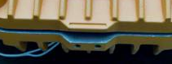
Steps:
B. Assemble a new lamp cover ( include glass)
Put the lamp cover on the enclosure. Ensure the juts in the lamp cover coincide with the same parts in the enclosure.
Check and ensure there is no dislocation of all parts
Fasten the screws.

Slide 18
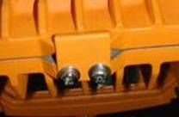
Steps:
C. Fix the hinges
Hinge 2
Hinge 1
Hinge 2
Hinge 1

Slide 19
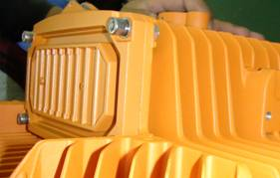
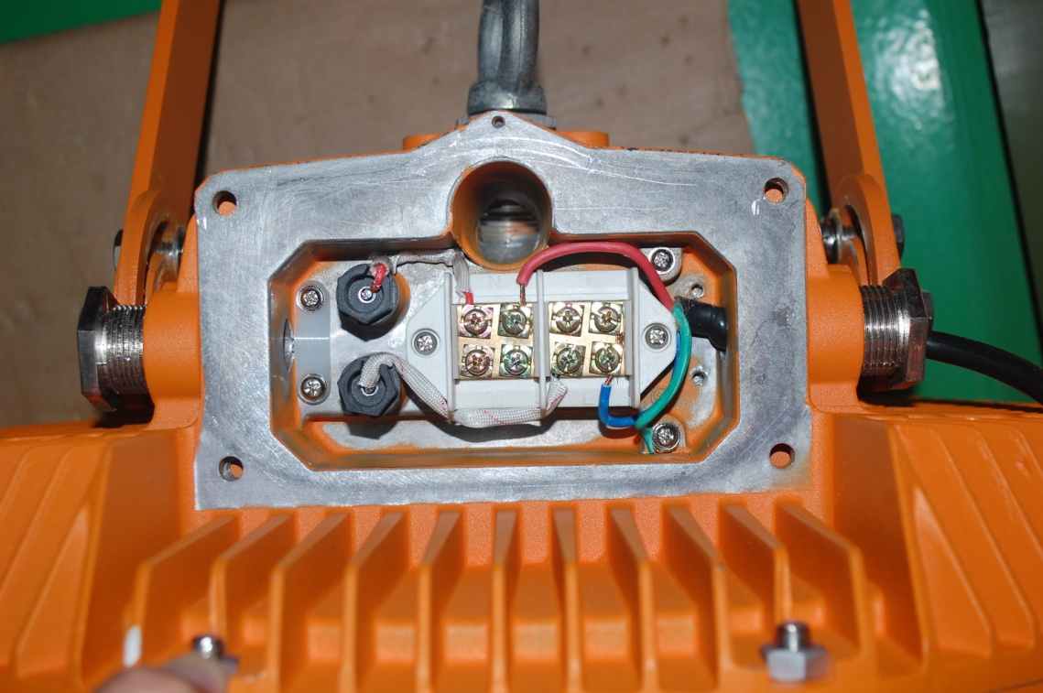
3. Lamp failure
3.1 Analysis: Power supply is failed
Solution: Measure whether the voltage is normal on the terminal block. If there is no power , check the power supply outside. If the voltage is normal , check the circuit inside.
Use the universal meter to measure the terminal block (L and N poles) and compare the value and the rated input voltage on the label.
Terminal block
Remove the cover

Slide 20
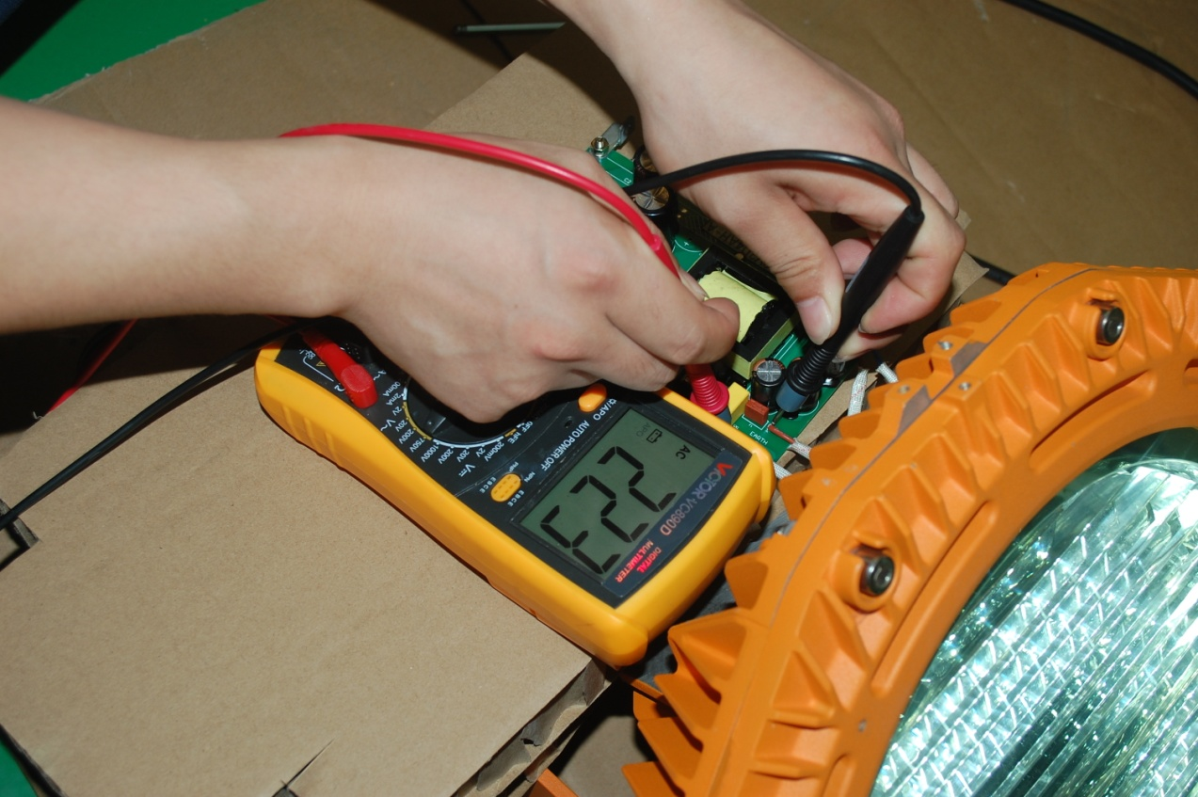
3. Lamp failure
3.2 Analysis: No power on the input terminal of the power supply board
Solution: Measure whether the voltage is normal on the input terminal of the power supply board. If there is no power , check whether there is poor contact from terminal block to the input terminal. If the voltage is normal , check other parts of the board.

Slide 21
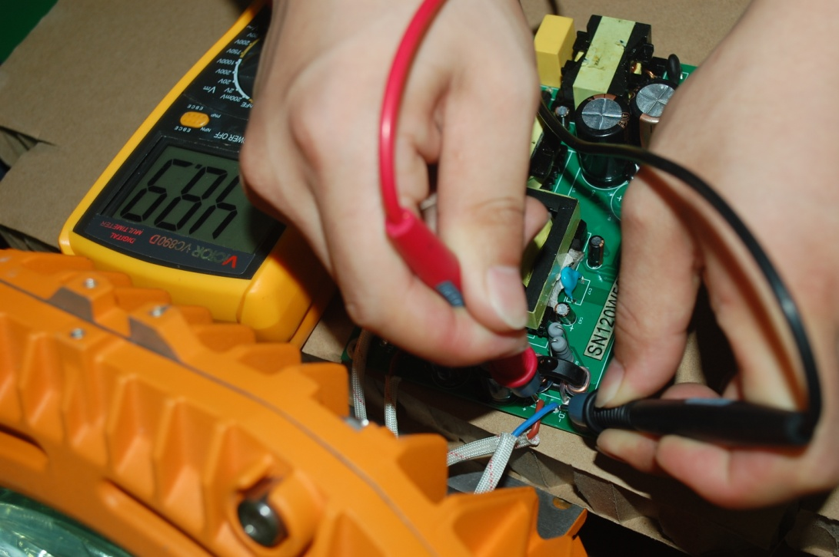
3. Lamp failure
3.3Analysis: the power supply board is failed
Solution: Observe whether some electronic components are damaged and give off bad smell. If not , measure whether the voltage is normal on the output terminal. If there is no voltage ( DC ) or very low , replace the power supply board . If the output is normal , check the LED board

Slide 22
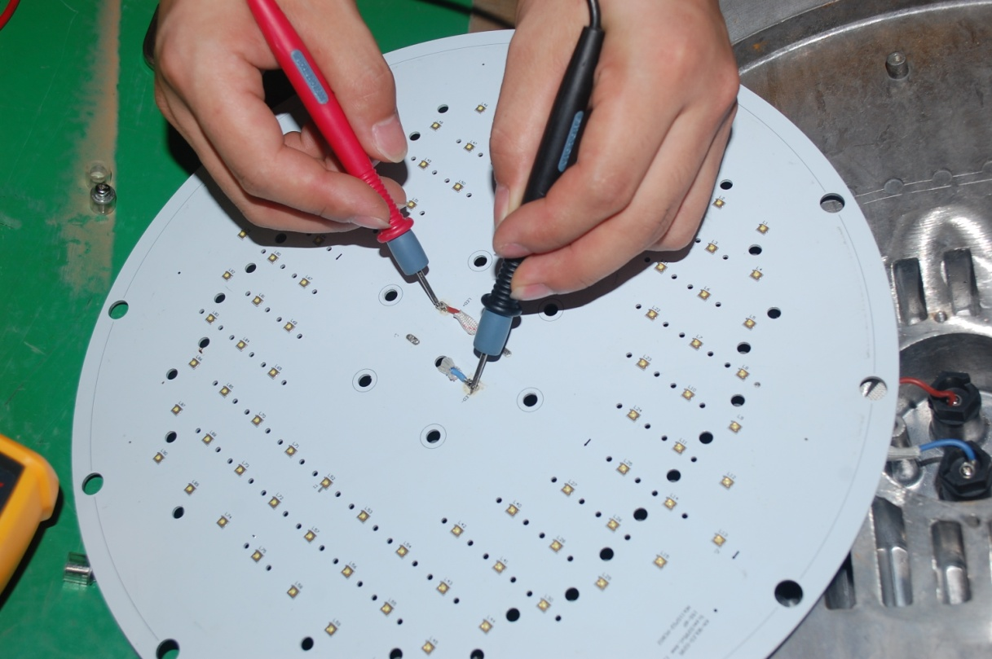
3. Lamp failure
3.4 Analysis: the LED board is failed
Solution: Measure the voltage between “+”and “-”on the LED board . If the voltage is normal , replace the LED board.
If not , check the cables and connector from the power board to the LED board, then measure again.

Slide 23
4. Some LED chips failure
4.1 Analysis: Parts of the LED chips are failed
Solution: Measure the voltage between “+”and “-”of the input terminal. If the voltage is normal , replace the LED board. If there is more high voltage ( DC ), check the power supply board

Slide 24
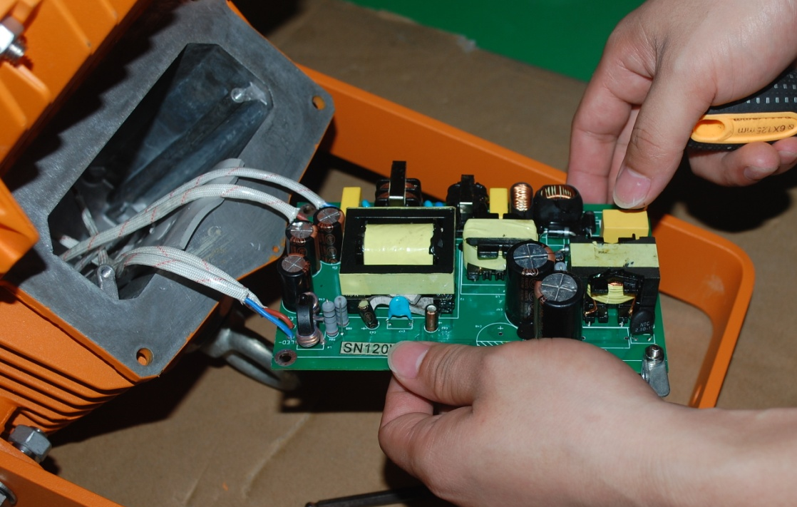
3、常见故障排查
3.6、灯具频闪
B、原因分析：灯具内部线路接触不良
故障排查及解决方法：因灯具使用时间过长而出现老化、灯具使用环境恶劣等因素，导致灯具内部元器件老化、接线处接触不良等。需要检测灯具内部各零部件、接线处是否正常。

Slide 25
5. LED flash rapidly
Analysis: Reference to the steps of 3. Lamp failure
Solution:

Slide 26
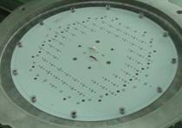
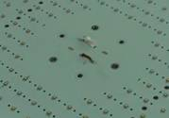
6. How to replace the LED board
Remove the lamp cover
Remove the reflector part
Remove the plastic sleeves
Unsolder the power cables and remove the LED board

Slide 27
6. How to replace the LED board
Open the package of the new LED board, install it by reverse operation of the 6 How to replace the LED board
Caution：
The lighting fixture should be energized more than 2 hours before tighten the screws to evaporate the water inside , then, shut down and tighten all screws.

Slide 28
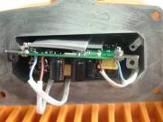
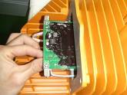
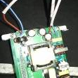
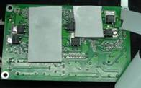
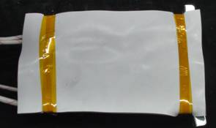
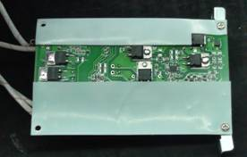
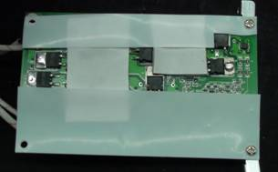
7. How to replace the power supply board
Draw out the power board
Open the side cover
Unsolder the power cables
Tear off the package
Dismantle the bracket

Slide 29
7. How to replace the power supply board
Open the package of the new power supply board, install it by reverse operation of the How to replace the power supply board
Caution：
The lighting fixture should be energized more than 2 hours before tighten the screws to evaporate the water inside , then, shut down and tighten all screws.

Slide 30
THANKS！

