Slide 1
KGoldenfrog Series
Operation&Maintenance Manual

Slide 2
Contents
Products… … … … … … … … … … … … … … … … … …2
Installation… … … … … … … … … … … … … … … … …4
Malfunction Diagnosis& Correction … … … … … … … … 13

Slide 3
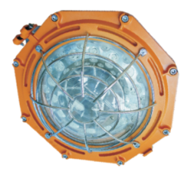
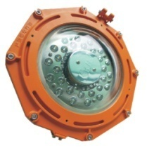
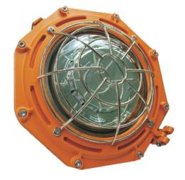
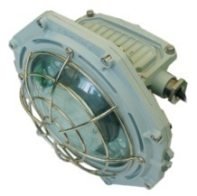
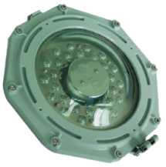
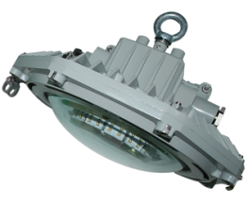
Product
Explosion Proof
Spotlight
High bay light
Floodlight
Non-explosion Proof
Spotlight
High bay light
Floodlight

Slide 4
Product
Introduction
A、LED source, aluminum alloy explosion proof housing, high intensity, small size and weight. light and driver integration design, indirection entrance cable, high safety and stability.
B、Application：
Mining: Coal mining tunnels, mine chambers, mine underground parking lots etc.
Explosion proof: oilfields, petrochemical plants, drilling platforms etc.
Industrial: factories, cement plants, coal washing plants and warehouse etc.
C、 Ambient Temperature: -40 -- +55℃;
D、Certification: ATEX: LCIE 12 ATEX 3070 X, IECEx: IECEx CQM 12.0033X

Slide 5
Installation
Caution：
1. To avoid electric shock, explosion or electric shock
This product should be installed and maintained by qualified electrician
only.
2. To avoid explosion
a. Make sure that power supply voltage is the same as the floodlight voltage.
b. Do not install where the marked operating temperatures exceed the ambient temperature of the hazardous areas.
c. Do not operate in ambient temperatures above those indicated on the floodlight nameplate.
3. To avoid electric shock
a. Make sure the electrical power is OFF before installation
and maintenance.
b. Luminarie housing must be grounded.
4. To avoid burning hands
Do not touch the luminarie while energized.

Slide 6
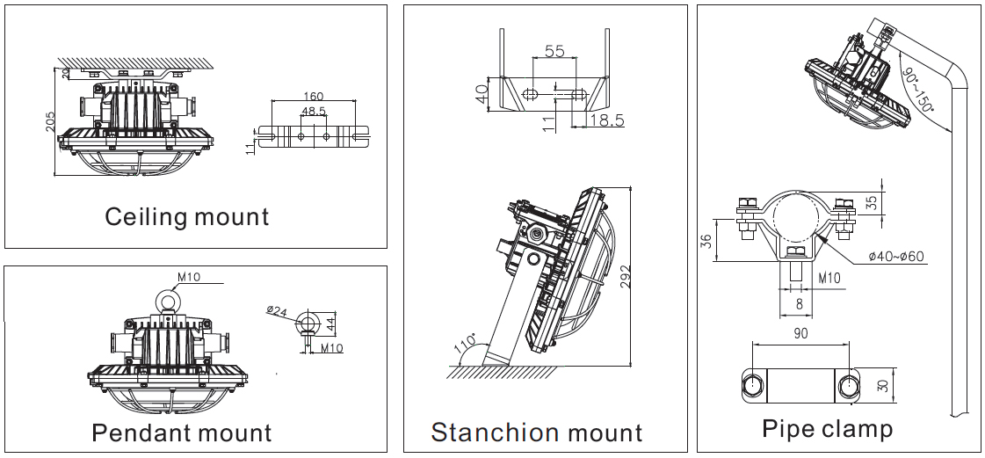
Installation
Different installations of KGoldenfrog series floodlight: pendant mount, ceiling mount, stanchion mount and pipe clamp. Please select the installation as needed.

Slide 7
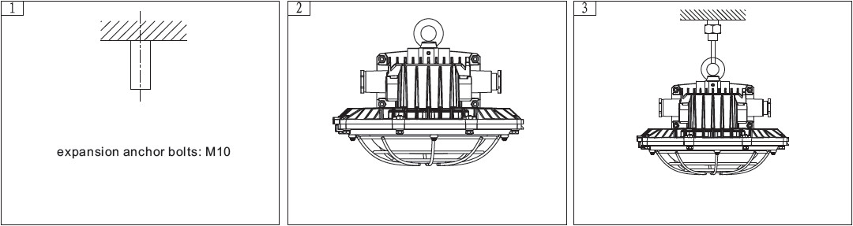
Installation
A、Pendant mount
Place expansion anchor bolts into the position where the light is about to be installed, fasten the loops to the light, use the steel wires to connect the expansion anchor bolts and loops.

Slide 8
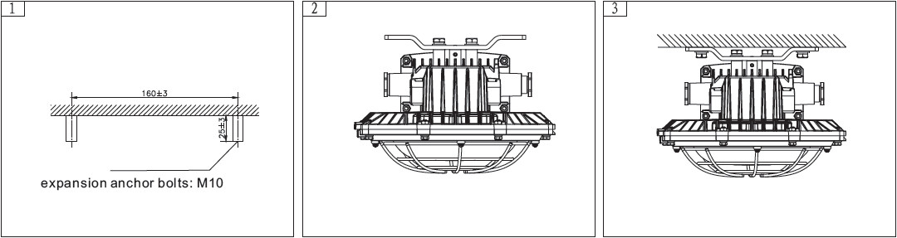
Installation
B、Ceiling mount
Place M10 expansion anchor bolts into the position where the light is about to be installed, install the brackets to the light with screws, fix the brackets and expansion anchor bolts and tighten the bolts nut.

Slide 9
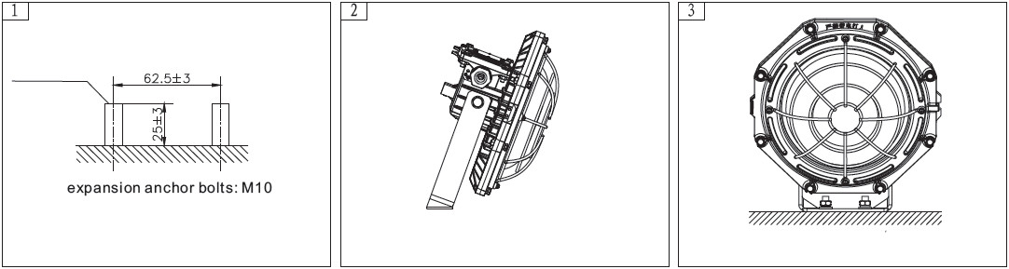
Installation
C、Stanchion mount
Place 2 pieces of M10 expansion anchor bolts into the position where the light is about to be installed, install the brackets to the light with screws, fix the brackets and expansion anchor bolts and tighten the bolts nut.

Slide 10
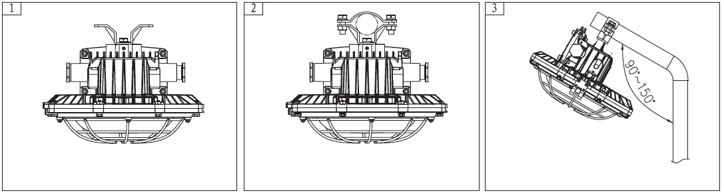
Installation
D、Pipe clamp
Dissemble the clamps, fasten half of the clamps onto the light and tighten the other half around the light pole together with light.

Slide 11

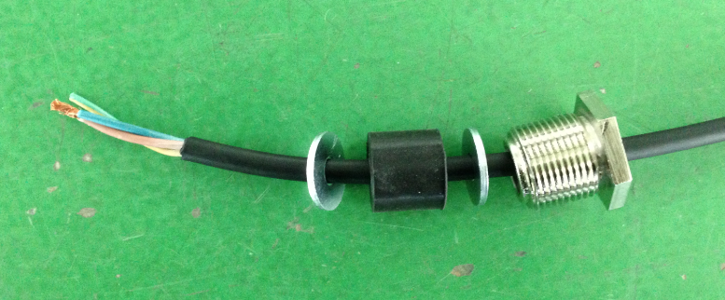
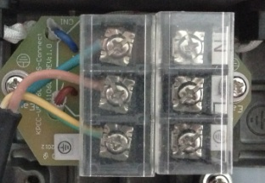
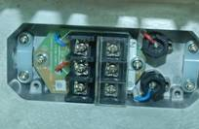
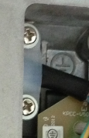
Installation
Wiring
Remove 4pcs M6 screws with 5mm hex wrench and open the side cover.
Put the cable through(in this order)nut, flat washer, rubber seal and flat washer to the cable terminal.
Connect all 3 wires to the terminal compartment through the PVC wire clips.

Slide 12
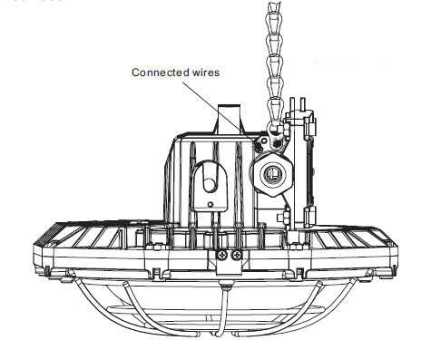
Installation
Safety Chain
Secure the safety chain to the ceiling to prevent any fall-off.
Fasten and secure it to the ceiling

Slide 13
Installation
Warnings
Do not use lights with missing parts.
Do not touch the enclosure and glass while energized.

Slide 14
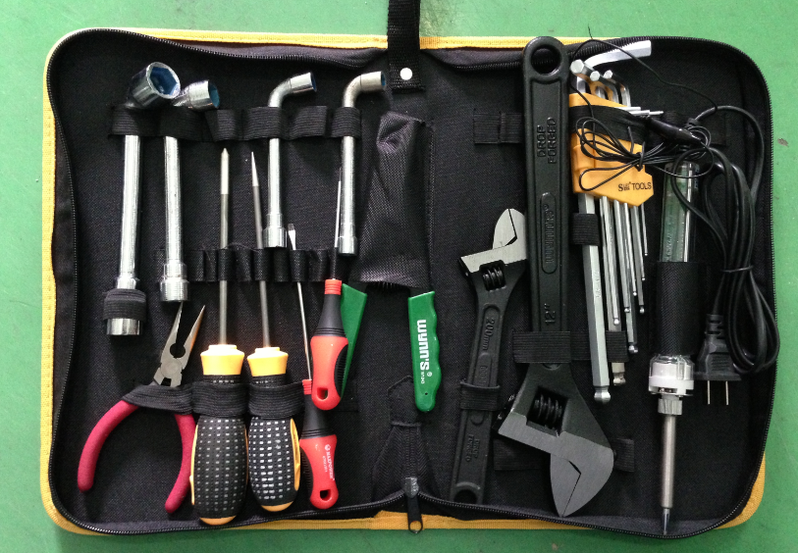
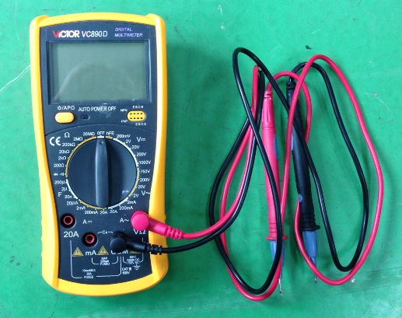
Malfunction Diagnosis& Correction
1.Tool kit
Cross screwdriver, straight screwdriver, hex wrench, adjustable wrench, flat nose pliers etc.
Multimeter

Slide 15
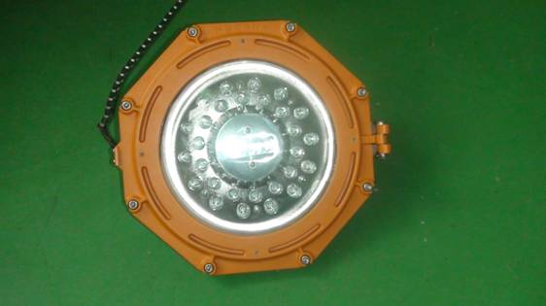
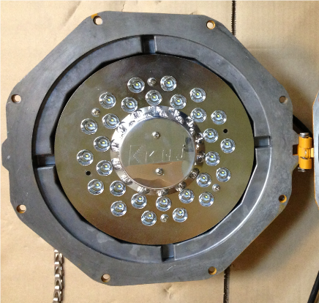
Malfunction Diagnosis& Correction
2. Glass cover breakup
Diagnosis：Any impact force over 20J can break the glass cover;
Correction：Replace the broken glass cover.
A. Open the cover and clean out the glass fragments
Remove all screws with 5mm hex wrench in counterclockwise.
Loosen the hinges with cross screwdriver in counterclockwise.

Slide 16


Malfunction Diagnosis& Correction
B、Replace with a new glass cover
1. Place the glass cover in the right position as shown
2. Make sure all the components are fixed correctly
3.Tighten the cover with M4 screws and washers

Slide 17
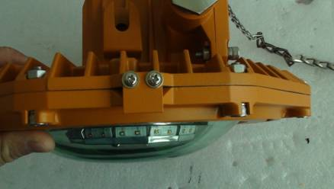
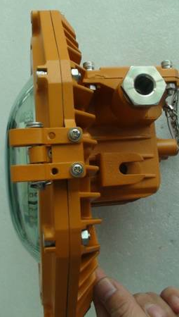
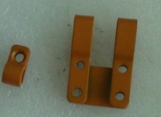
Malfunction Diagnosis& Correction
C、Install hinges
Tighten the hinges with cross screwdriver
Tighten the hinges part 2 with sunk screws to the front cover and part 1 with pan head screws to the back cover
Hinges part 2
Hinges part 1

Slide 18
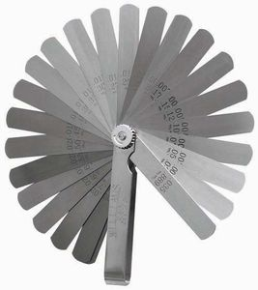
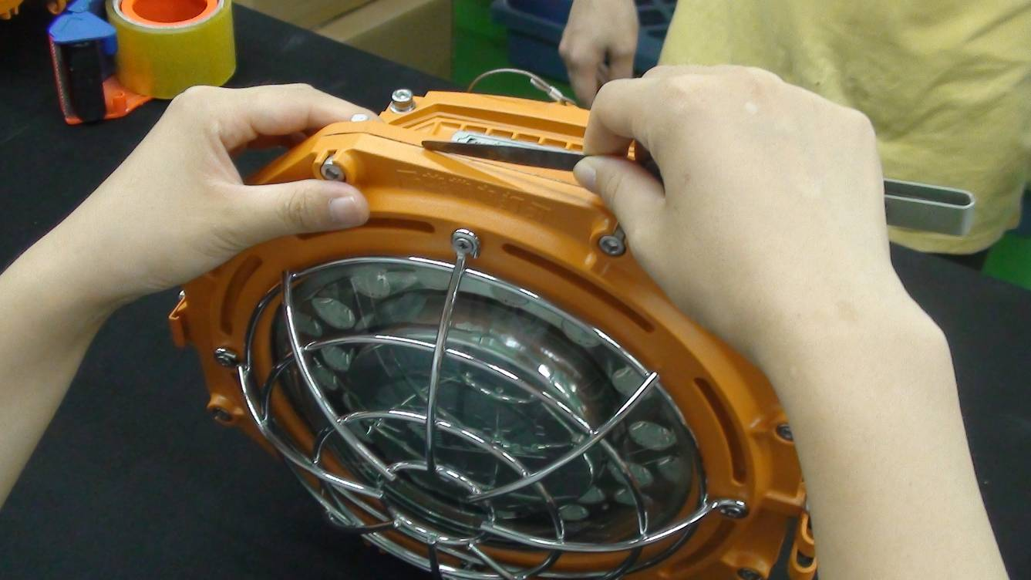
Malfunction Diagnosis& Correction
D、After replacement, the gap of flameproof joint must be checked.
Make sure the gap must be less than 0.2 mm
Feeler Gauge

Slide 19
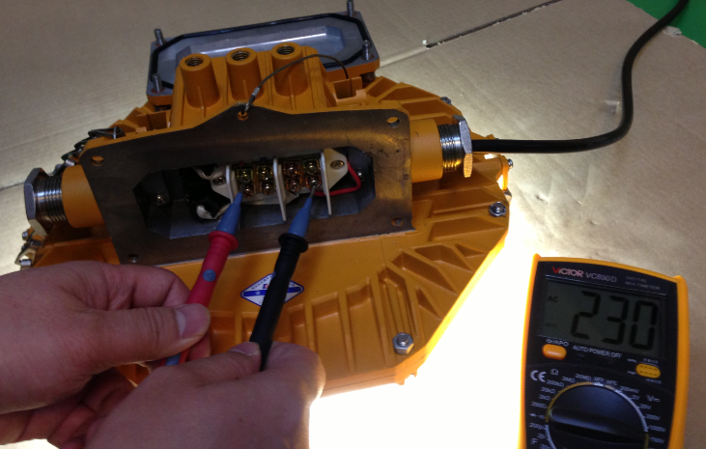
Malfunction Diagnosis& Correction
3. All LEDs stop working
A、Diagnosis：no input voltage
Correction:
1. Test the voltage at input cable socket;
2. Test the power supply system if no input voltage is detected at cable socket;
3. Continue testing the light circuit if above 2 steps show no malfunction.
Set multimeter to AC750V, test the voltage in wiring terminals(there are 3 voltage ranges of KGoldenfrog series:100-240V AC, 24-48V AC/DC, 10-30V DC), 100-240V AC is used in the following cases
Open the side cover with 5mm hex wrench.

Slide 20
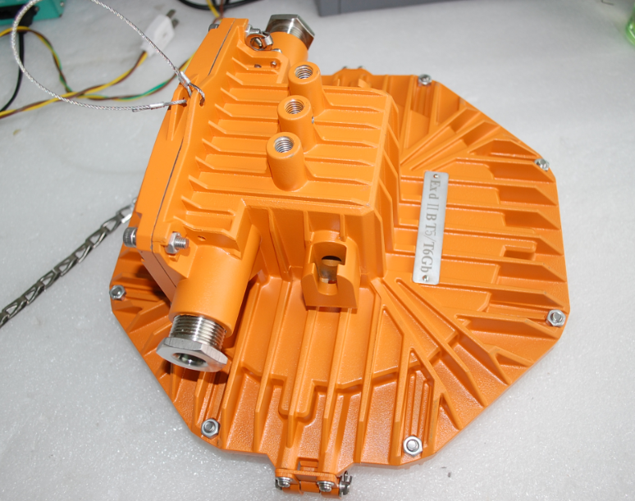
Malfunction Diagnosis& Correction
3. All LEDs stop working
A、Diagnosis：no input voltage
After putting back the side cover, gap of flameproof joint must be checked
Make sure the gap must be less than 0.2 mm
Feeler Gauge

Slide 21
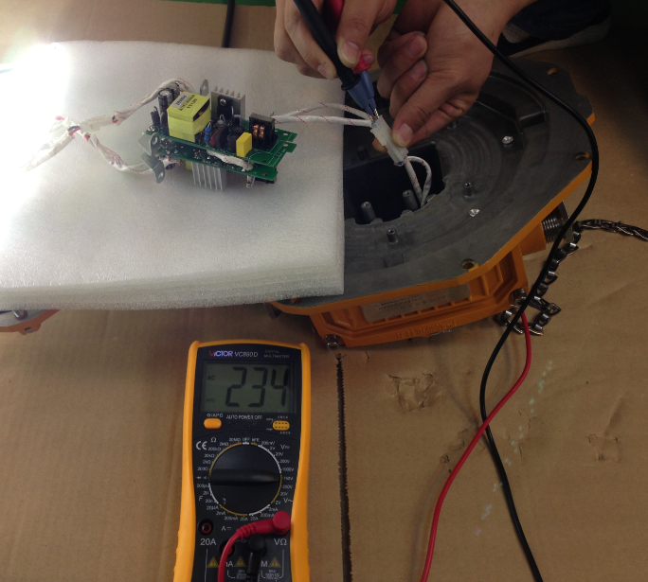
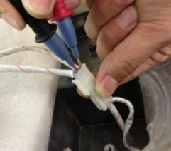
Malfunction Diagnosis& Correction
3. All LEDs stop working
B、Diagnosis: Poor contact at input voltage switch on power supply Printed Circuit Board Assembly(PCBA)
Correction: Set multimeter to AC 750V, test the output voltage at power supply system and switch on power supply PCBA:
1. No voltage, check the cable connection and wire terminals
2. Normal voltage, continue checking power supply PCBA
Normal voltage

Slide 22
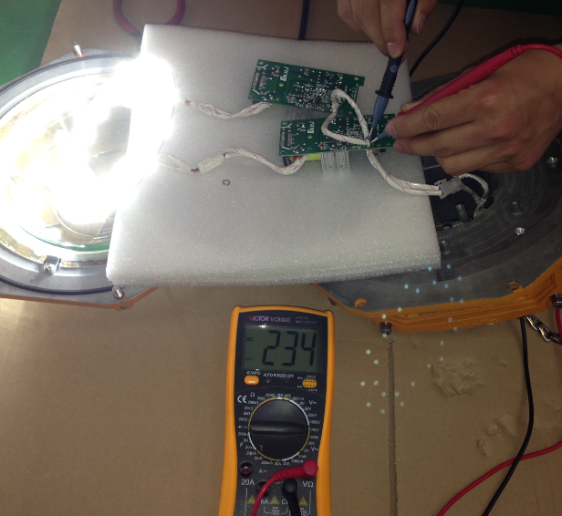
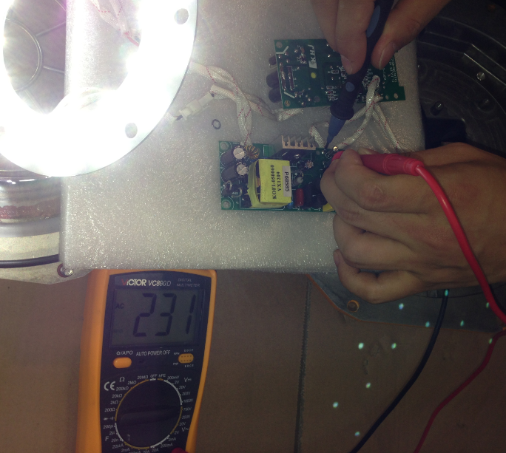
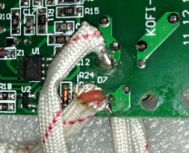
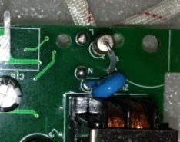
Malfunction Diagnosis& Correction
3. All LEDs stop working
C. Diagnosis：no input voltage at power supply PCBA
Correction： Set multimeter to AC 750V, test the input voltage at power supply system:
1. No voltage, check the cable connection
2. Normal voltage, continue checking power supply PCBA
Normal
voltage

Slide 23
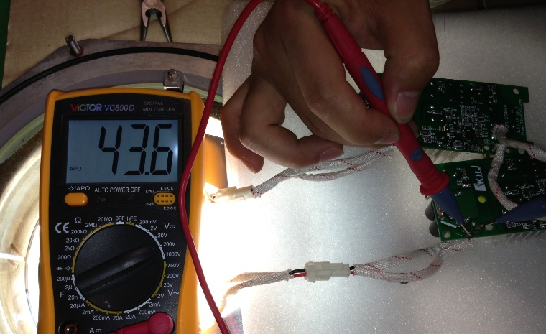
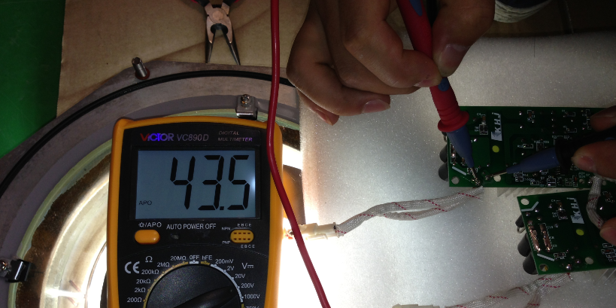
Malfunction Diagnosis& Correction
3. All LEDs stop working
D、Diagnosis：broken power supply PCBA, no input voltage
Correction：1. Check if any electric component burnout and unpleasant odor exist
2. Input voltage being detected as normal, set multimeter to DC 200V, red needle(+) and black needle(-) to test output voltage, replace the power supply PCBA if there is no output voltage, continue testing LED PCBA if output voltage is normal
Normal Voltage

Slide 24
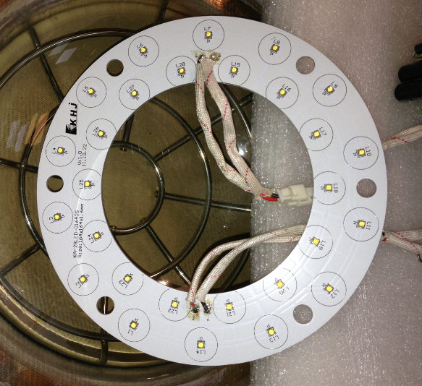
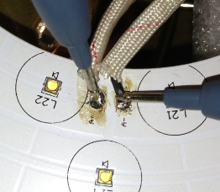
Malfunction Diagnosis& Correction
3. All LEDs stop working
D、Diagnosis：broken LED PCBA, test the LED PCBA after replacing it
Correction：
Set multimeter to DC 200V, red needle(+) and black needle(-) to test input voltage at LED PCBA, replace the LED PCBA if inpput voltage is normal
It is the open circuit of wires connecting LED PCBA and power supply PCBA, test the voltage again after welding the wires back.
Normal voltage

Slide 25
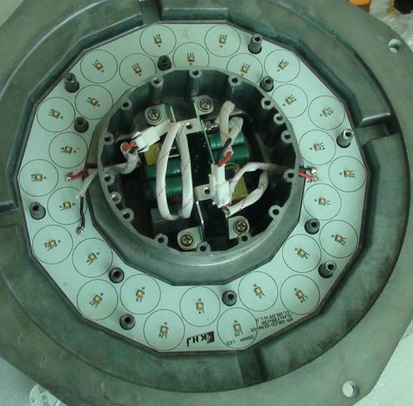
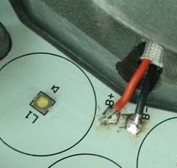
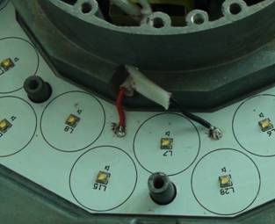
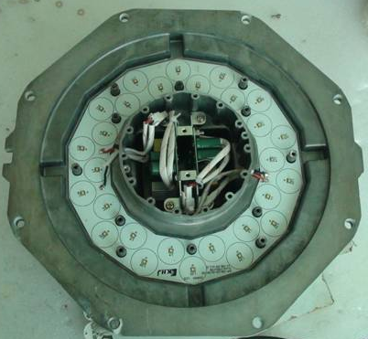
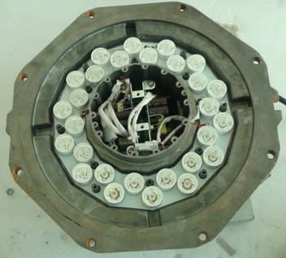
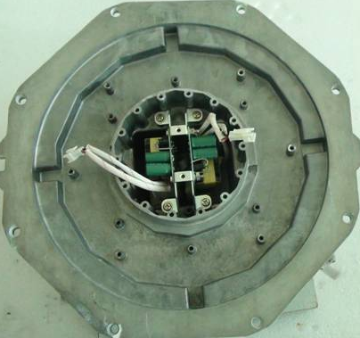
Malfunction Diagnosis& Correction
Beam angle 15° Spotlight LED PCBA replacement
1. Place the PCB in the right position
2. Pull Female pin through PVC Silicone Fiberglass Sleeving and weld it to the PCB, red pin to A+ and B+, black pin to A- and B-, clean the welding spot and fasten the wires
3. Lightly spin the reflectors of LEDs till they are fastened

Slide 26
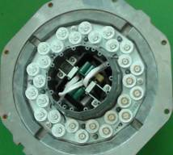
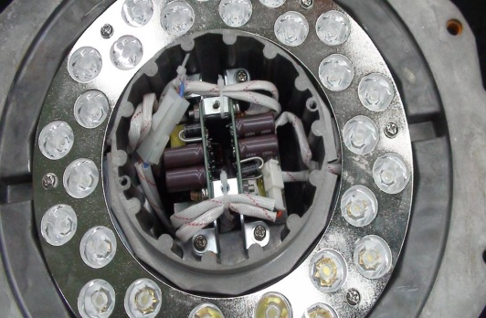
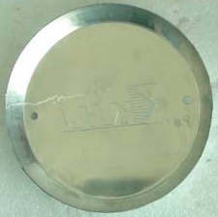
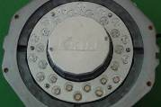

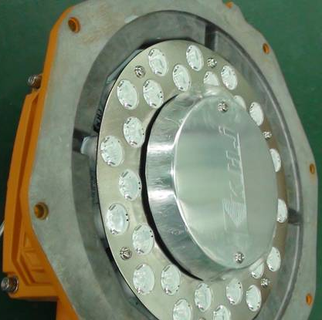
Malfunction Diagnosis& Correction
Beam angle 15° Spotlight PCB replacement
3. Fasten the aluminum cover, make sure the LOGO is in alignment with text on the housing；
2. Secure the wires with ties
1. Cover reflectors with the fixed plate, and fasten it with washers
4. Alignment with the text on the housing
TIPS：Test the light while energized after replacement

Slide 27
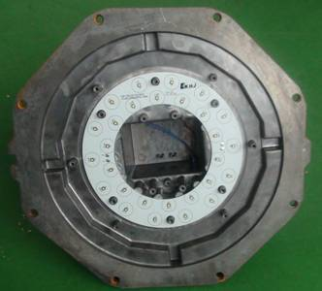
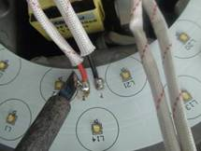

Malfunction Diagnosis& Correction
Beam angle 15° Spotlight PCB replacement
1. LEDs components:
Alignment with the text on the housing
2. Pull Female pin through PVC Silicone Fiberglass Sleeving and weld it to the PCB, red pin to A+ and B+, black pin to A- and B-, clean the welding spot and fasten the wires
3. Plug the pins, make sure they are plugged in place and tighty

Slide 28




Malfunction Diagnosis& Correction
Beam angle 80° High bay light PCB replacement
1.Fasten the reflectors components to the lights in place
2. Fasten the aluminum cover, make sure the LOGO is in alignment with text on the housing
TIPS：Test the light while energized after replacement

Slide 29








Malfunction Diagnosis& Correction
Beam angle 180° Floodlight PCB replacement
3. Put on washers
2.Fold the insulation PVC in 90°；
1. Fasten the LED PCBA to the light, pull wires through the holes
4. Fasten the LED PCBA to the light with insulation PVC and screws.

Slide 30



Malfunction Diagnosis& Correction
Beam angle 180° Floodlight PCB replacement
3. Plug power supply male and PCB female, secure both input and ouput wires with ties
4. Put washers on screws and install the reflecting plate
1. Pull terminal wires through PVC Silicone Fiberglass Sleeving and out of the wire holes, weld them to the PCB, red pin to "+", black pin to "-"
2. Pull terminal wires through PVC Silicone Fiberglass Sleeving and out of the wire holes, weld them to the PCB, red pin to "+", black pin to "-"

Slide 31


Malfunction Diagnosis& Correction
Beam angle180°floodlight PCB replacement
1. Fasten the aluminum cover, make sure the LOGO is in alignment with text on the housing；
TIPS：Test the light while energized after replacement

Slide 32
Malfunction Diagnosis& Correction
4. Part of LEDs stop working
A. Diagnosis: no voltage in 1 one of the power supply PCB
Correction： Set multimeter to AC 750V, test the input voltage at PSB, on which LEDs are not working; and test the output voltage at power supply PCBA (DC 200V)
Power supply PCBA output End
Normal voltage
Power supply PCBA Input End

Slide 33
Malfunction Diagnosis& Correction
4. Part of LEDs stop working
B、 Diagnosis: LED PCBA malfunction
Correction: Set multimeter to DC 200V, test the input voltage of the broken LEDs, replace the LED PCBA if the voltage is normal
Normal
Voltage

Slide 34
Malfunction Diagnosis& Correction
4. Part of LEDs stop working
A、Diagnosis: Excessive power supply input voltage breaks part of LEDs, replace the LED PCBA
Correction:
Test the power supply voltage, and take turns to test the power supply system, PSB output voltage as stated above. And replace the LED PCBA according to the instructions above, beam angle 15°and 80°lights carry the LEDs in 1 piece of PCBA, beam angle 180°light carries a line of 14 pieces of PCBAs
Normal Voltage

Slide 35


Malfunction Diagnosis& Correction
A line of 14 pieces of PCBAs, can be
replaced individually
1 piece of PCBA
Beam angle 15°
Material code：4002210201016
Beam angle 80°
Material code：4002210201014
Beam angle 180°
Material code：4002210201009

Slide 36

Malfunction Diagnosis& Correction
Explosion proof KGoldenfrog carries 2 lines of 14 series-connected LEDs in parallel connection.

Slide 37
Malfunction Diagnosis& Correction
5. Flickering light
A. Diagnosis: unstable power supply voltage, possibly low voltage results in electric components malfunction
Correction: Set multimeter to AC 750V to test input voltage
Normal voltage
Open the side cover with 5mm hex wrench.

Slide 38
Malfunction Diagnosis& Correction
5.Flickering light
B. Diagnosis: power supply PCBA malfunction
Correction: In condition of normal power supply voltage and power supply PCBA input voltage, set multimeter to DC 200V to test if any situation of great output voltage fluctuation or low voltage exists, power supply PCBA shall be replaced if it does
Power supply PCBA output end
Normal voltage

Slide 39
Malfunction Diagnosis& Correction
5.Flickering light
C、Diagnosis: LED PCBA malfunction
Correction: Replace the power supply PCBA if light still flickers with normal voltages at power supply system, power supply PCBA output end and LED PCBA input end
Normal voltage

Slide 40



Malfunction Diagnosis& Correction
5.Flickering light
D、Diagnosis: improper contact of circuit inside the light
Correction: long time working and harsh application environment results in aging electric components and improper contact. Test the key components, wires terminals etc. inside the light

Slide 41
Thank you！

