Slide 1
Arowana series maintenance guide

Slide 2
Contents
1 General information … … … … … … … … … … … 2
2 Installation guide … … … … … … … … … … … … 4
3 Common malfunctions and maintenance … … 13

Slide 3
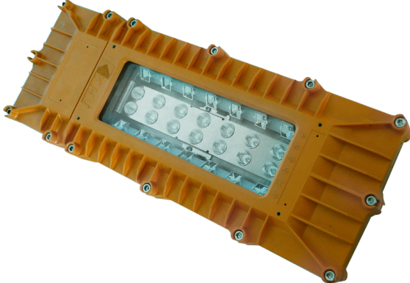
1. Appearance
Explosion Proof LED Flood Light

Slide 4
2. Product summary
A. Features
This series adopts LED lighting module which features high efficiency, high lumen output and long lifespan. Adopting integrated design, the lighting fixture is made of high strength aluminum alloy.
Junction box and LED lighting source are isolated to increase the safety and reliability.
B. Main purpose and applicable scope
Applicable the flammable places in oil field, Petroleum industry , petrochemical industry, etc.
C. The ambient temperature is -40℃to +55℃
D. Certificate
PCEC(China)/ATEX/IECEX

Slide 5
1. Caution
A. Installation and maintenance should be done by professional staff
B. Avoid explosion
a. Ensure that the voltage of power supply is within the range marked on the label
b. Don’t install the product in any flammable places that the temperature is over the temperature level marked on the label
C. Prevent electric shock and burns
a. Forbidden install or maintain with power
b. The enclosure should be earthed reliably
c. Don’t touch the transparent parts to prevent burns when it is power on

Slide 6
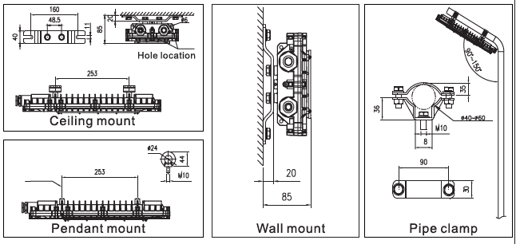
2. Installation
There are 4 mounting types: ceiling mount , pendant mount , wall mount , pipe clamp mount. Please select the mounting type according to the actual requirement.

Slide 7
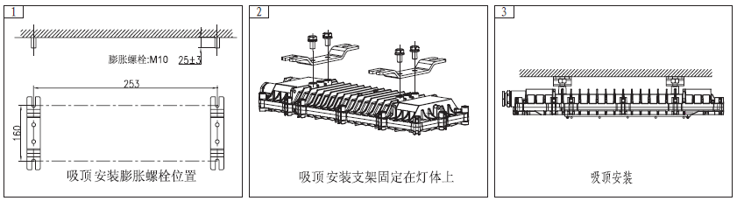
2. Installation
A. Ceiling mount
Install 2 expansion bolts at the predetermined position on the ceiling according to the holes in the bracket . Mount the bracket on the enclosure . Connect the bracket to the 2 expansion bolts and fasten them.

Slide 8
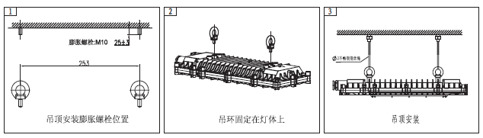
2. Installation
B. Pendant mount
Install 2 expansion bolts at the predetermined position on the ceiling according to the ring bolt holes in the enclosure. Mount the 2 ring bolts in the enclosure . Connect the ring bolts to the 2 expansion bolts with wire rope and fasten them.

Slide 9
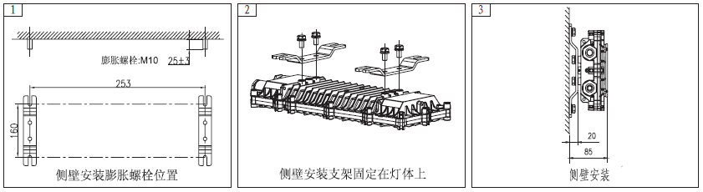
2. Installation
C. Wall mount
Install 2 expansion bolts at the predetermined position on the wall according to the holes in the bracket. Mount the bracket on the enclosure . Connect the bracket to the 2 expansion bolts and fasten them.

Slide 10
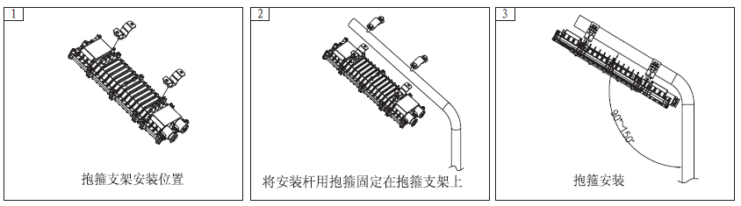
2. Installation
D. Pipe clamp mount
Mount the A parts of the 2 pipe clamps on the enclosure, and fix the B parts on the lighting pole. Then connect the A parts to the B parts with bolts and fasten them.

Slide 11
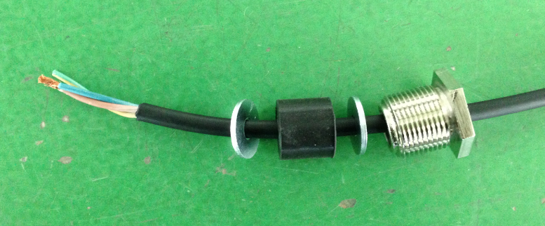
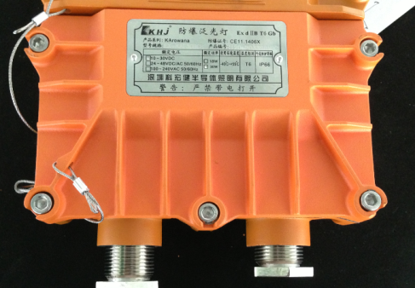
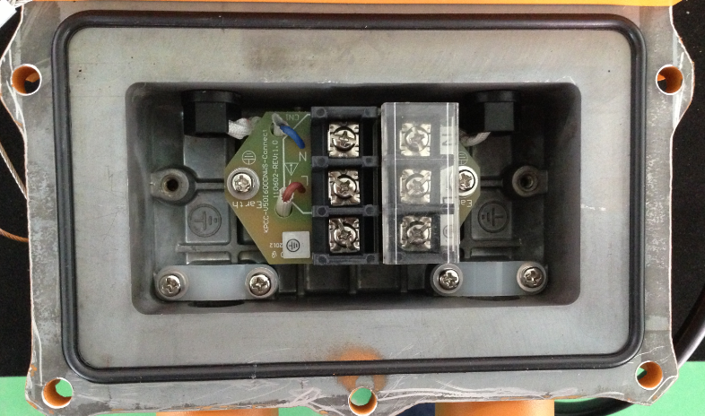
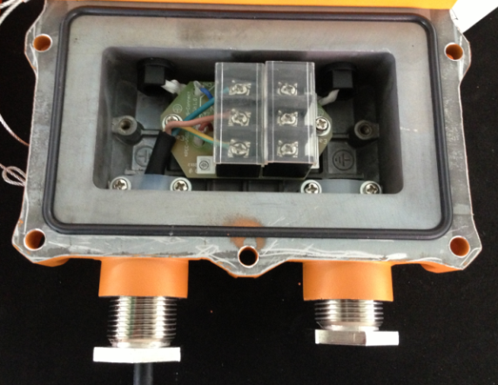
3. Electrical connection
Loosen the inner hexagonal bolts by 5mm screw driver and remove the cover
Loosen the cable gland and insert the cable from outside through the cable gland into the terminal box.
Cable should be pressed tightly under the cable anchorage
Unlock the screws on the terminal and introduce the wires , then fasten the screws.

Slide 12
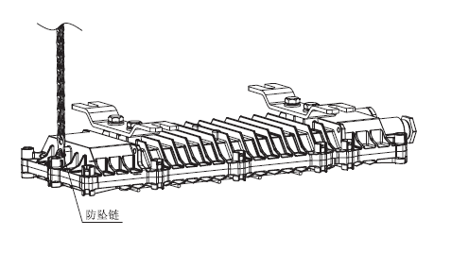
4. Fall proof chain
Fix one end of the chain to the enclosure and the other end to the mounting surface so as to prevent the lighting fixture to fall accidentally.

Slide 13
5. Operation caution
Not use the lighting fixture lacks some parts.
Do not touch the enclosure or glass to avoid the burns to your hands during the operation.

Slide 14
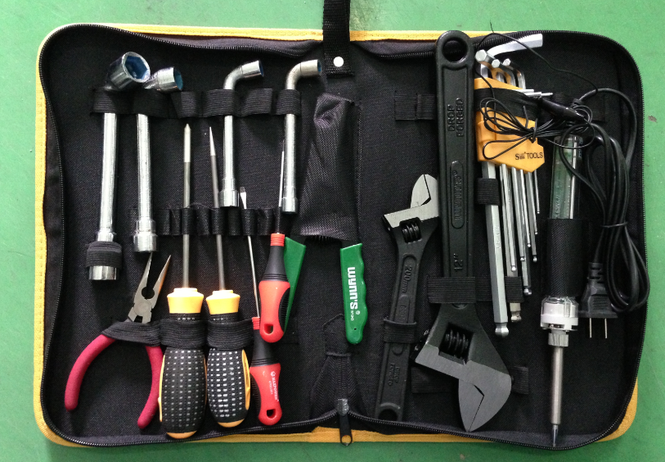
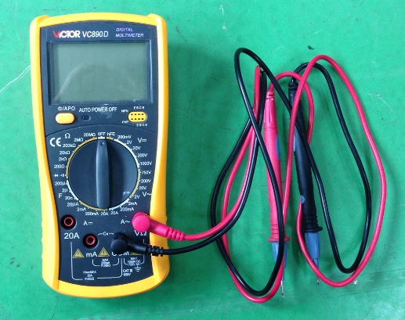
1. Preparation of tools
Common tools：
Philips screwdriver , straight screwdriver , internal hexagonal wrench ,
adjustable spanner , pliers , etc.
Universal meter

Slide 15
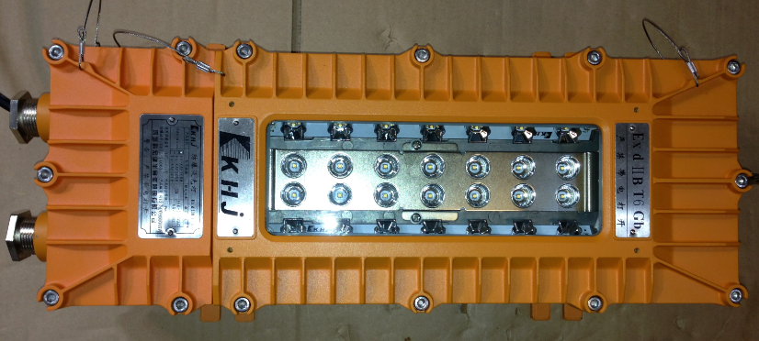
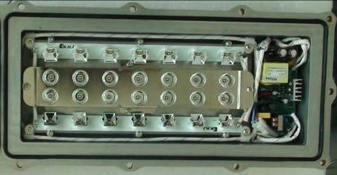
2. Crack on the glass
Analysis: The impact energy on the glass is over 20J that is the max. limit for the toughened glass
Solution: replace the lamp cover ( include the glass )
Steps :
A. loosen the screws with 5mm inner hexagonal wrench and remove the cracked cover
Cut off the fall-proof chains by diagonal pliers

Slide 16
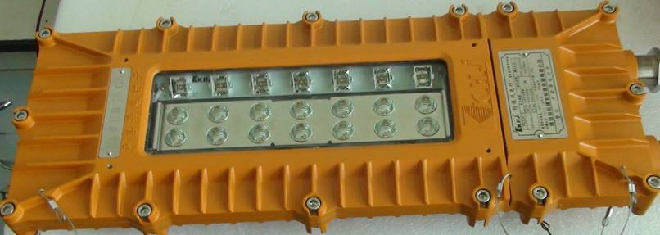

Steps:
B. Assemble a new lamp cover ( include glass)
Put the lamp cover on the enclosure.
Check and ensure there is no dislocation of all parts
Fasten the screws.
Fix the fall-proof chains
Use special crimping pliers to fasten the fall-proof chain

Slide 17
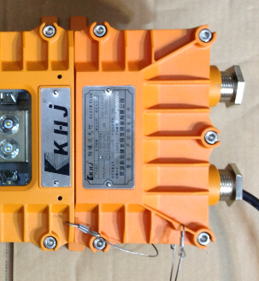
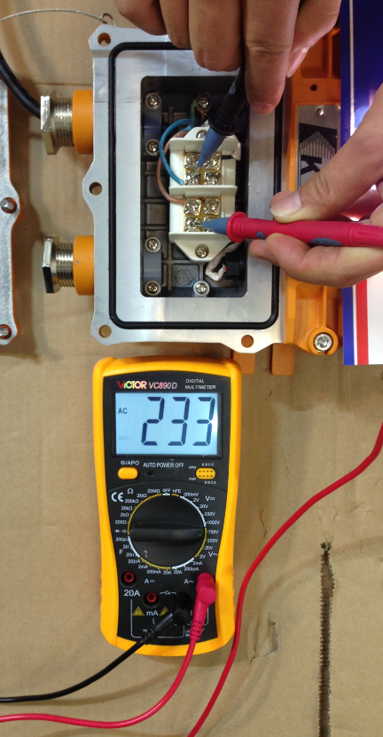

3. Lamp failure
3.1 Analysis: Power supply is failed
Solution: Measure whether the voltage is normal on the terminal block. If there is no power , check the power supply outside. If the voltage is normal , check the circuit inside.
Use the universal meter to measure the terminal block (L and N poles) and compare the value and the rated input voltage on the label.
Remove the cover

Slide 18
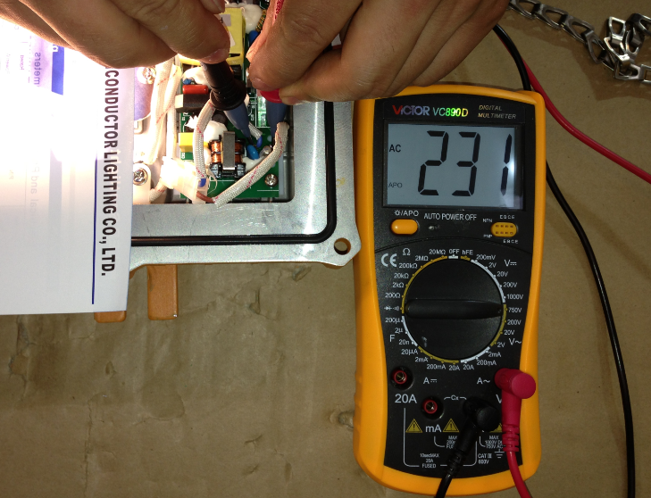
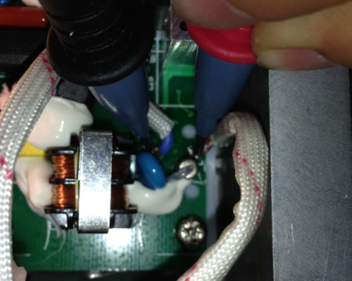
3. Lamp failure
3.2 Analysis: No power on the input terminal of the power supply board
Solution: Measure whether the voltage is normal on the input terminal of the power supply board. If there is no power , check whether there is poor contact from terminal block to the input terminal. If the voltage is normal , check other parts of the board.

Slide 19
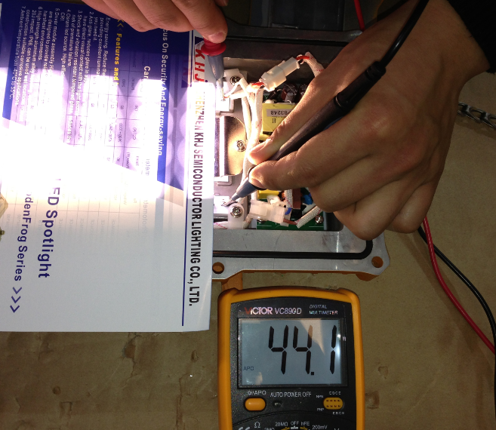
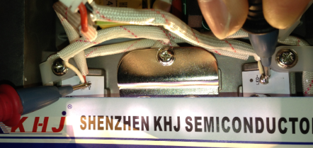
3. Lamp failure
3.2 Analysis: the power supply board is failed
Solution: Observe whether some electronic components are damaged and give off bad smell. If not , measure whether the voltage is normal on the output terminal. If there is no voltage ( DC ) or very low , replace the power supply board . If the output is normal , check the LED board

Slide 20
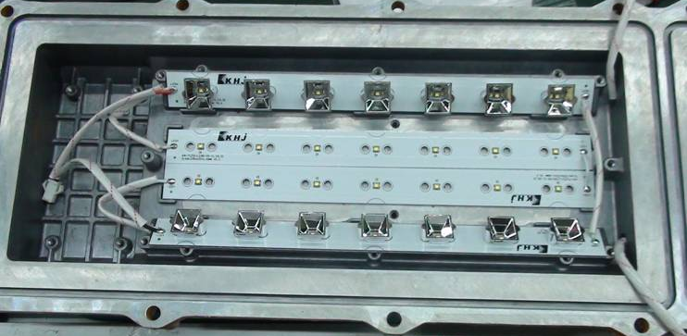
3. Lamp failure
3.2 Analysis: the LED board is failed
Solution: Measure the voltage between “+”and “-”on the LED board . If the voltage is normal , replace the LED board.
If not , check the cables and connector from the power board to the LED board, then measure again.

Slide 21
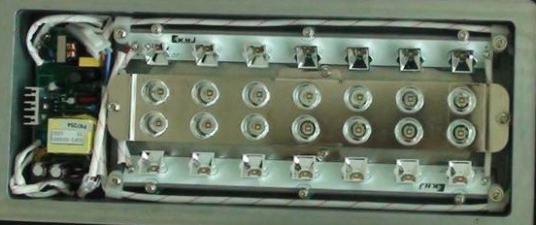
4. Part of LED failure
4.1 Analysis: The power cable disconnect
Solution: There are 4 piece of LED boards connected together. Observe which LED board is failed and check the power cable to this board. If the cable disconnect from the board, weld them by soldering iron again .
If the cable are normal , replace this board.

Slide 22
5. LED flash rapidly
Analysis
Solution:
Reference to the steps of 3. Lamp failure

Slide 23
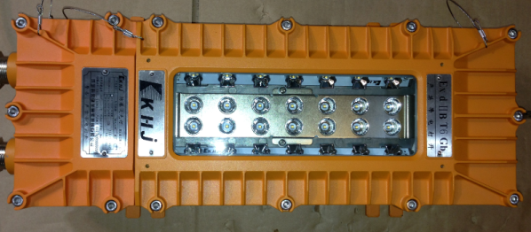
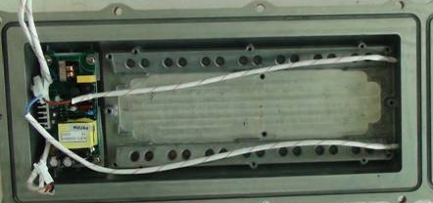
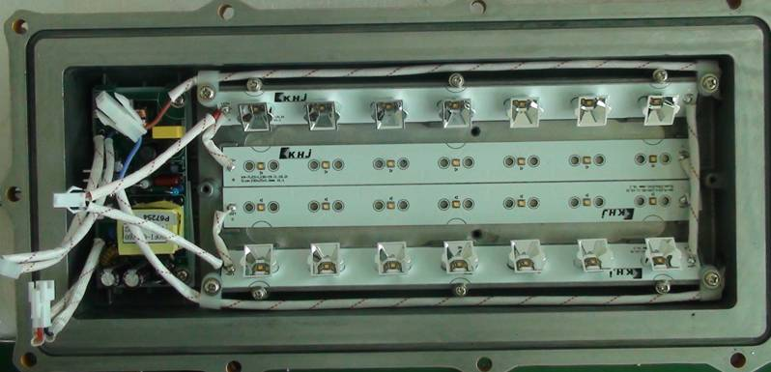
6. How to replace the LED board
6.1 remove the failed LED board
Loosen the bolts , remove the reflector
Disconnect the LED board and power board
Remove the cover
Loosen the bolts , remove the LED board . Then, dismantle all of the reflector cups on the LED board

Slide 24
6. How to replace the LED board
6.2 Install the new LED board
Open the package of the new LED board , install it by reverse operation of the 6.1 remove the failed LED board
Caution：
The lighting fixture should be energized more than 2 hours before tighten the screws to evaporate the water inside , then, shut down and tighten all screws.

Slide 25
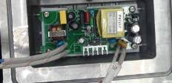
7. How to replace the power supply board
7.1 remove the power supply board
Disconnect the power board and terminal block
Disconnect the LED board and power board
Remove the cover
Loosen the 4 bolts
Remove the power board

Slide 26
7. How to replace the power supply board
7.2 Install the new power supply board
Open the package of the new power supply board, install it by reverse operation of the 7.1 remove the power supply board
Caution：
The lighting fixture should be energized more than 2 hours before tighten the screws to evaporate the water inside , then, shut down and tighten all screws.

Slide 27
THANKS！

